Slide 1
Trauma Sensitive Schools within VTSS
TFI 1.5 Understanding Problem Behavior
Notes:
The next module is going to move into 1.5: Understanding Problem Behavior

Slide 2
What you will know and do
As a result of this learning, participants will...
Understand components of behavior to include:
ABC’s (antecedent, behavior, consequence)
Setting events
Function
How these components can manifest with students who have experienced trauma
Notes:
Let’s take a minute to review our learning intentions.
As a result of this learning, participants will...
Understand components of behavior to include:
ABC’s (antecedent, behavior, consequence)
Setting events
Function
How these components can manifest with students who have experienced trauma
Action planning: Behavior definitions through the trauma sensitive lens, communication plan to all stakeholders.

Slide 3
Roadmap
TFI | Mental Health Planning Tool | A-TFI
1.5 Problem Behavior Definitions: School has clear definitions of problem behaviors that interfere with academic and social success and a clear policy/procedures for addressing office managed versus staff managed. | 1.5 Mental Health Enhancement: The flowchart includes an expanded section on preventative strategies. The school team includes interventions that support mental wellness, setting events and functions of behavior within the flowchart. Internalizing and externalizing behaviors are addressed in behavior descriptions. | 1.5 Aligned Curricula Measures of student performance include goals with student success feature and are communicated to students.
Notes:
As always, our focus is on alignment. The TFI for 1.5 focuses on making sure that your school has clear definitions of problem behaviors that interfere with academic and social success as well as a clear policy/procedure for addressing office managed versus staff managed. You will notice that the academic TFI focused on aligned curricula making sure that measures of student performance include goals with student success features that are clearly communicate to students.
What does this look like:
Referral procedures include ways to track students leaving their instructional environment (e.g visits to the nurse or school counselor) so the needs of youth with internalizing as well as externalizing challenges inform the behavior definition process.
Additional information about fight, flight, freeze and appease (fawn) behaviors are shared with teachers and staff.

Slide 4
Remember...
SHARED DEFINITIONS
CLASSROOM VS. OFFICE MANAGED
Why would having shared definitions of behaviors be important?
What impact would agreements about classroom managed vs. office managed behaviors have on our school?
Notes:
When thinking back to new team training, remember that in 1.5 we discussed the importance of establishing shared definitions of behaviors. From there we moved into agreements about classifying behaviors as classroom managed versus office managed in order to respond consistently across the school. Later this morning, we will be focusing on appropriate responses but first we really need to take a hard look at our understanding of behavior. Why do students behave the way they do? What factors contribute to behaviors and how does trauma impact those factors? We have to start with this foundation before we can consider how to respond.

Slide 5
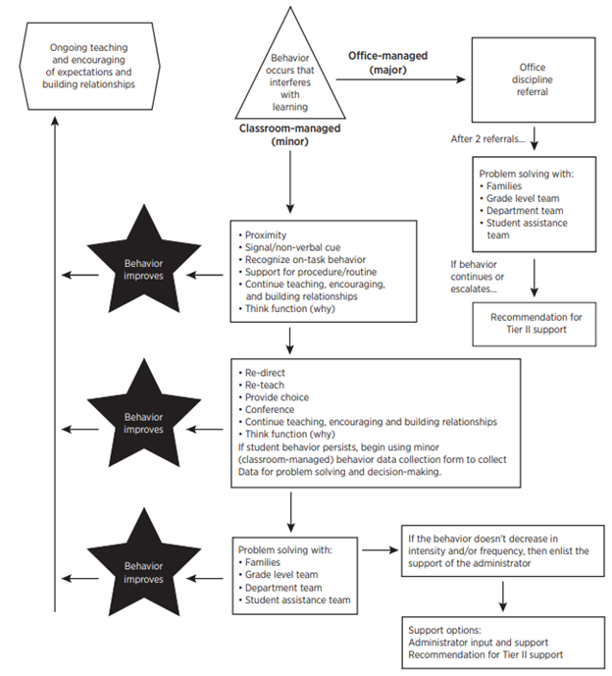
Remember
Notes:
The flowchart includes an expanded section on preventative strategies. The school team includes interventions that support mental wellness, setting events and functions of behavior within the flowchart. Internalizing and externalizing behaviors are addressed in behavior descriptions.
What does this look like:
Referral procedures include ways to track students leaving their instructional environment (e.g visits to the nurse or school counselor) so the needs of youth with internalizing as well as externalizing challenges inform the behavior definition process.
Additional information about fight, flight, freeze and appease (fawn) behaviors are shared with teachers and staff.

Slide 6
The Science of Behavior
There is no mis-behavior!
The Behavior is Feedback for us…
A trigger for us to think...
Where is the mismatch?...
What instruction needs to happen?
Notes:
This is so important. (Go through the slide transitions) We have to rethink discipline. We have to think of behavior in terms of instructional opportunities. Not with value judgments on behavior based on our norms or values. We use this as feedback for us...to think..where is the mismatch between what is happening and our expectations? What instruction needs to happen?

Slide 7
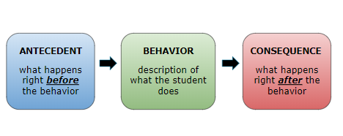
ABC’s of Behavior
Notes:
You may have seen this slide explaining the ABC’s of behavior and it is important to understand that this is how you determine what instruction needs to take place. We have to determine the “why”, the function of behavior in order to #1 prevent it and #2 respond appropriately. (Go through the slide).
Manual: https://drive.google.com/open?id=1b7_XV0WMO1e1rtU5HIJnkFmf7QcHv4Zi

Slide 8
Trauma and Behavior
Behavior is the language of trauma, especially for children
Most children lack the language skills to describe how they are feeling, so behavior is their expression
Most expressive behaviors used by children are considered “negative”
Some of the most challenging behaviors are strategies that have helped the child to survive abusive or neglectful situations and have been generalized to other environments (e.g., school)
Notes:
We know that behavior is the language of trauma. Most children lack the language skills to describe how they are feeling, so behavior is their expression. They might not be able to express that they are feeling angry or frustrated, scared or excited so they demonstrate behavior that would be considered negative. (Give examples)
It is important to remember that for students who have experienced trauma, these challenging behaviors are strategies that have helped them survive abusive or neglectful situations. We learn behaviors from our collective experiences and those behaviors generalize to other environments.

Slide 9
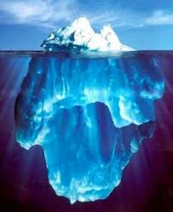
Setting Events
OBSERVABLE BEHAVIOR
SETTING EVENTS/ ACES
Notes:
Let’s dive into some of the factors that contribute to the function of behavior. We will begin with setting events. When we are determining function of behavior we have to remember that there are a number of layers to peel back. We have to look beneath the surface for what we call setting events.

Slide 10
Breaking down the definition
An event occurring before or with an antecedent that increases the likelihood of a behavior
Sets up the behavior (slow trigger)
Sometimes is present and sometime is not
Does not require one’s awareness
(systemic and developmental trauma)
Notes:
A setting event is an event that occurs before or with an antecedent that increases the likelihood of a behavior
It can be viewed as a slow trigger setting up the behavior
It is important to remember that sometimes it is present and sometimes it is not and it does not require your awareness.
This is especially true for students who have experienced systemic or developmental trauma. the acute instance (like a death or car accident) is not always present but that doesn’t mean the setting events are not an influencing factor on behavior.

Slide 11
Multiple Setting Events
Environmental | Social | Physiological | Classroom
Noise level Being late Moving to a new home Transitions Temperature Back and forth between quarantine and home | Family Crisis Systemic Racism Fight Negative Social Interactions Loss of Loved One Ableism Family divorce Heterosexism Misogyny Social Media Challenges | Sickness Sleep problems Agitation due to anxiety, depression Medication changes or side effects Mental Illness | Instructional match Noise level Crowded space Transitions Time of Day Being late without materials Peers/Staff/ Teacher

Slide 12
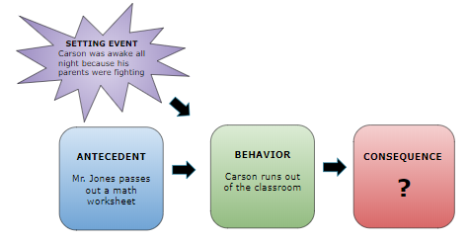
Expanded look at ABCs
Notes:
Setting events are a very important piece of the function of behavior puzzle and you can see here where they fit in. Setting events can occur before or with the antecedent. They increase the likelihood of a behavior as you can see in this example.

Slide 13
Let’s Chat!
What setting events might your students be dealing with?
Notes:
What setting events might your students be dealing with?

Slide 14
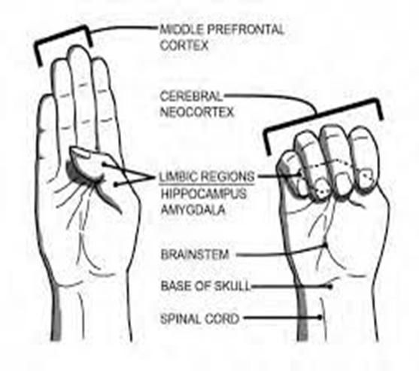
How Does Trauma Impact Students in the Classroom?
Notes:
We’ve talked about ABC’s of behavior as well as setting events so no let’s take a look at a few more considerations when responding to behavior through a trauma sensitive lens. A reminder of what we talked about before: When students are going about their day it is helpful if they have access to their frontal lobe. They need to be able to retrieve previously learned information, regulate their emotions, interact with their peers and adults appropriately, and problem solve. Unfortunately, students who have experienced trauma may not have access to those skills because are focused on survival and the perceived threat around them.
This is significant when considering why students behave the way they do.

Slide 15
Additional Considerations when Responding to Behavior
Students impacted by trauma are often ready to “flip their lid”
Allison Sampson-Jackson video
Notes:
video: 4:40 https://vimeo.com/109042767
This video explains why it is so important that students be able to access their frontal lobe and considerations when responding.

Slide 16
Survival Brain
Increased
Decreased
Emotional instability
Anxiety
Irritability
Anger
Frustration
Impulsivity with regards to language or actions
Problem solving
Communication skills
Emotional regulation
Ability to retrieve previously learned information
Decision making
Notes:
When an individual is functioning in their survival brain there is an increase in emotional instability and impulsivity (with regards to language or actions). However, other functions decrease. Individuals have a lowered ability to problem solve, interact, communicate, regulate our emotions, retrieve previously learned information, plan and make decisions.
Think about the impact this has on students in your classrooms, hallways, cafeterias etc.

Slide 17
Fight, Flight, Freeze, Appease
Notes:
When a child in functioning in survival brain or is faced with a situation that causes them fear or stress, they will have one of four reactions. They will fight, flee (flight), freeze or appease. You have likely heard of fight, flight or freeze but there is an additional category, called appease that we are going to explain in a moment. When a child is in fight, they will demonstrate behaviors that could be labeled as aggressive. They may take something out of another student’s hand, they may yell or run at you, or cry and throw themselves on the floor. A child who is experiencing flight will usually be looking for a way to escape. They may attempt to run out of the classroom, hide under a desk or cover their ears. A student who is experiencing freeze may become quiet, they may look around the room or stumble over their words. You may not see any behavior at all but they may still be functioning in survival brain. The last category is appease. This is also referred to as fawn or submit. Children who are experiencing appease may simply go along or comply with the request given because they see that as the only safe alternative. It is important for us, as educators, to remember that even though they may seem calm and compliant, they may actually be functioning in survival brain.

Slide 18
Breakout Discussion
Review the resource provided in the chat box
Identify behaviors you have seen your students exhibit.
Pay close attention to the last column, what stands out to you?
Notes:
Breakout: 5 minutes- Put Flight/Fight/Freeze/Appease Resource in the Chat: https://docs.google.com/document/d/1Z5NHh74dOsvfvKW7uYLmEFjT4Lt4mFSL/edit (Whitney…where can we put this so that hey can access it?)
We wanted to take a few minutes to let you explore these concepts.(If tight on time just refer them to this) Please refer to the handout on these four reactions. Take note of the the columns as told from the students perspective. Look through the chart and identify behaviors you may have seen your students exhibit. Pay close attention to the last column which highlights ways you can support students when they are in survival brain.

Slide 19
Internalizing Versus Externalizing
Notes:
Chat box response: How can we, as educators, increase our level of awareness with regards to internalizing behaviors.

Slide 20
Functional Relationships
Notes:
All of this information brings us to this point. It’s all about functional relationships. Behavior is purposeful and it serves a function.

Slide 21
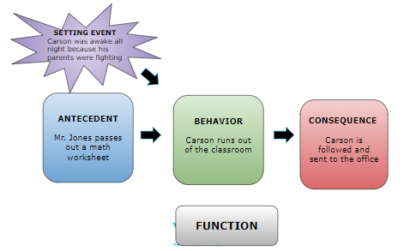
Expanded look at ABCs Continued
Notes:
We all repeat certain behaviors if they work for us (i.e. are reinforced) (go through as a reminder)
It is a cycle and as long as the function is being met, then the behavior will continue.

Slide 22
Possible Functions of Behavior
GET/OBTAIN | ESCAPE/AVOID
Choice | Tasks: demand or request
Attention (interaction with peers or adults) | A specific person/group of people
Objects | Objects (undesired)
Activity (desired/pleasurable) | Activity (undesired/hated)
Self-stimulation/sensory input | Sensory input
Justice or Fairness | Protest a lack of fairness, justice (do not use “revenge”)
 | Protest a lack of choice (do not use “control”)
Notes:
When you are looking at behavior as a science it is helpful to understand that it can be divided into two possible functions: (Go through)

Slide 23
Understanding Function
The topography of the behavior may look the same
(i.e. running out of the classroom); however, the behavior may serve different functions for the individual under different circumstances and may serve different functions for different individuals.
Notes:
It is important to understand that the topography of the behavior may look the same but may serve different functions. It may serve different functions for the individual under different circumstances and may serve different functions for different individuals.

Slide 24
Effective Interventions
Carson runs out of the classroom in order to escape the demands of the assignment
Carson runs out of the classroom in order gain access to the cafeteria
Carson runs out of the classroom in order to gain attention from the teacher
Carson runs out of the classroom because it is too loud in the class (i.e. escape sensory)
Notes:
(Read through examples)
We need to identify function in order to develop effective interventions

Slide 25
Behavior is the language of trauma
“ Many children develop behavior coping mechanisms in an effort to feel safe and in control, yet these behaviors can frustrate educators and evoke exasperated reprisals, reactions that both strengthen the child’s expectations of confrontation and danger and reinforce a negative self-image.”
Notes:
Remember that behavior is the language for trauma. A child’s behavioral response to traumatic events can lead to lost learning time and strained relationships with teachers and peers. For many children who have experienced traumatic events, the school setting can feel like a battleground in which their assumptions of the world as a dangerous place sabotage their ability to remain calm and regulate their behavior in the classroom.
References: https://traumasensitiveschools.org/trauma-and-learning/the-problem-impact/

Slide 26
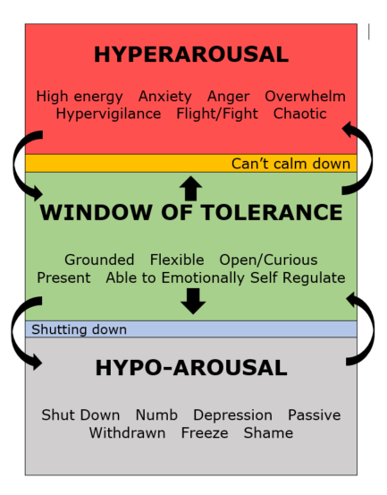
Window of Tolerance
Notes:
We wanted to give you a visual to summarize this section and to keep in mind when considering the behavior of your students, your friends, family and yourself. Take a look at the window of tolerance. For optimal functioning, you want to be in the green (Read through) If you are in a state of hyperarousal, the area in red, you may be feeling (read through). This is when you are overstimulated, your brain is not accessing the frontal lobe as well as it should. If you are in a state of Hypo-arousal, the area in gray, you may be feeling (read through). This is also tough because you lack access not only to your frontal lobe at times but the motivation to access the frontal lobe. It is important to note that students or adults who have experienced trauma may move in and out of both of these states and it may be harder for them to return to their window of tolerance. Remember the video, connect before correct. Wendi is going to go through response strategies but it is important for you to understand this concept.

Slide 27
A Sense of Urgency
Suicide is the 2nd leading cause of death among high school aged youth 14-18
Nearly 1 in 3 parents (31%) shared that their child’s mental health is worse than before the pandemic.
In 2019, more than 1 in 3 high school students said they experienced persistent feelings of sadness or hopelessness, 1 in 5 seriously considered suicide.
In 2020, the percentage of emergency department visits increased by 24% for children ages 5-11 and by 31% for youth ages 12-17 compared to the same period in 2019.
Notes:
America’s School Mental Health Report Card (Feb. 2022) https://hopefulfutures.us/wp-content/uploads/2022/02/Final_Master_021522.pdf
Curtin SC, and Heron M. Death Rates Due to Suicide and Homicide Among Persons Aged 10-24: United States, 2000-2017. 352. NCHS Data Brief, 2019. Panchal N, Kamal R, Cox C, Garfield R, Chidambaram P. Mental Health and Substance Use Considerations Among Children During the COVID-19 Pandemic. 2021. Kaiser Family Foundation.
Kessler RC, Berglund P, Demler O, Merkangas KR, Walters EE. Lifetime Prevalence and Age-of-Onset Distributions of DSM-IV Disorders in the National Comorbidity Survey Replication. Arch Gen Psychiatry. 2005;62(6):593-602.
Lipari RN, Hedden S, Blau G, and Rubenstein L. Adolescent mental health service use and reasons for using services in specialty, educational, and general medical settings. The CBHSQ Report: May 5, 2016. Center for Behavioral Health Statistics and Quality, Substance Abuse and Mental Health Services Administration, Rockville, MD.
Leeb RT, Bitsko RH, Radhakrishnan L, Martinez P, Njai R, Holland KM. Mental Health–Related Emergency Department Visits Among Children Aged <18 Years During the COVID-19 Pandemic — United States, January 1–October 17, 2020. MMWR Morb Mortal Wkly Rep 2020; 69:1675–1680. Centers for Disease Control and Prevention. Youth Risk Behavior Survey Data Summary & Trends Report 2009-2019. 2020.
In 2019, more than one in three high school students said they experienced persistent feelings of sadness or hopelessness
one in five students seriously considered suicide.
In 2020, the percentage of emergency department visits increased by 24% for children ages five to 11 and by 31% for youth ages 12 to 17 compared to the same period in 2019.
Suicide is the second leading cause of death among high-school aged youth 14-18
Nearly 1 in 3 parents (31%) shared that their child’s mental health is worse than before the pandemic

Slide 28
Needed Perspective Shift
Function of Behavior
Setting Events
ABC’s
Survival Brain
Instructional Opportunities
Notes:
In order to understand and support students impacted by trauma, we need to change how we view them.
We must stop seeing them as willfully acting out to disrupt the classroom or consciously refusing to engage with learning.
Rather, we need to dig deeper and look at the puzzle pieces. (Read through)

Slide 29
Small Group Work
How can we share information regarding function of behavior and how it manifests with individuals who have experienced trauma with our staff and faculty?
Given this information, what adjustments need to be made to our behavior definitions and flow chart to include trauma sensitive proactive and preventative practices?
Notes:
Breakout Session: 10 minutes
Chat box:
How can we share information regarding function of behavior and how it manifests with individuals who have experienced trauma with our staff and faculty?
Given this information, what adjustments need to be made to our behavior definitions?

