Slide 1
Trauma Sensitive Schools within VTSS
TFI 1.9 Feedback and Acknowledgement

Slide 2
What we will know and do
Understand the benefits of behavior specific praise, affirmations, and mantras
Understand why praise does not work for some students
Action Plan: School-Wide Acknowledgement Matrix to include acknowledging staff and students

Slide 3
Roadmap
TFI | Mental Health Planning Tool | A-TFI
1.9 Feedback and Acknowledgment:A formal system (i.e., written set of procedures for specific behavior feedback that is (a) linked to school-wide expectations and (b) used across settings and within classrooms) is in place and used by at least 90% of a sample of staff and received by at least 50% of a sample of students. | 1.9 Feedback and Acknowledgement: Staff encourages, prompts and reinforces the utilization of social emotional skills | 1.9 Student Involvement: Instruction includes opportunities for students to participate in (a) the process of setting learning goals; (b) tracking of progress towards the learning goals; and © metacognitive reflection on learning

Slide 4
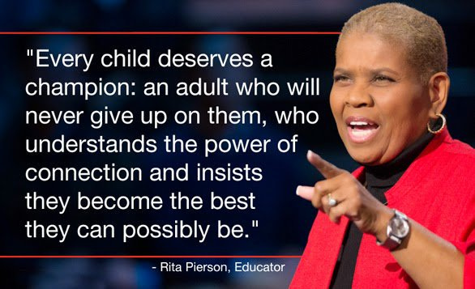
Interactions can be a lifeline
We have fewer interactions with hard-to-reach students.

Slide 5
Differential Treatments: Low Achievers
Get less wait time.
How can we integrate more wait time?
Are criticized more often for failure.
How can we use behavior specific praise, mantras, and affirmations?
Are pressed less frequently.
How can we build trusting relationships that includes challenging them to grow and reach their full potential?
Are called on less often.
How can you include all voices?
Are seated further away from the teacher.
How can you create a physical environment that supports a sense of belonging?
ASCD - Nancy Frey

Slide 6
Continued
Have less eye contact from the teacher.
How can you give opportunities to respond and eye contact when culturally appropriate?
Have fewer friendly interactions with the teacher.
How can you get to know all your students and engage in non-academic conversations?
Their ideas are accepted less accepted.
How can you create an environment that includes all voices?
ASCD - Nancy Frey

Slide 7
5 Positives to 1 Negative
Students should experience predominantly positive interactions
(5 positives: 1 negative)
in the classroom.
For students in vulnerable situations, the frequency is higher: 10:1 or 13:1

Slide 8
How does 5 to 1 happen?
Making eye contact
Asking if assistance is required
Smiling or nodding
Welcoming
Offering a greeting
Providing positive feedback regarding appropriate behavior
Maintaining an attitude of respect and support, even when correcting behavior

Slide 9
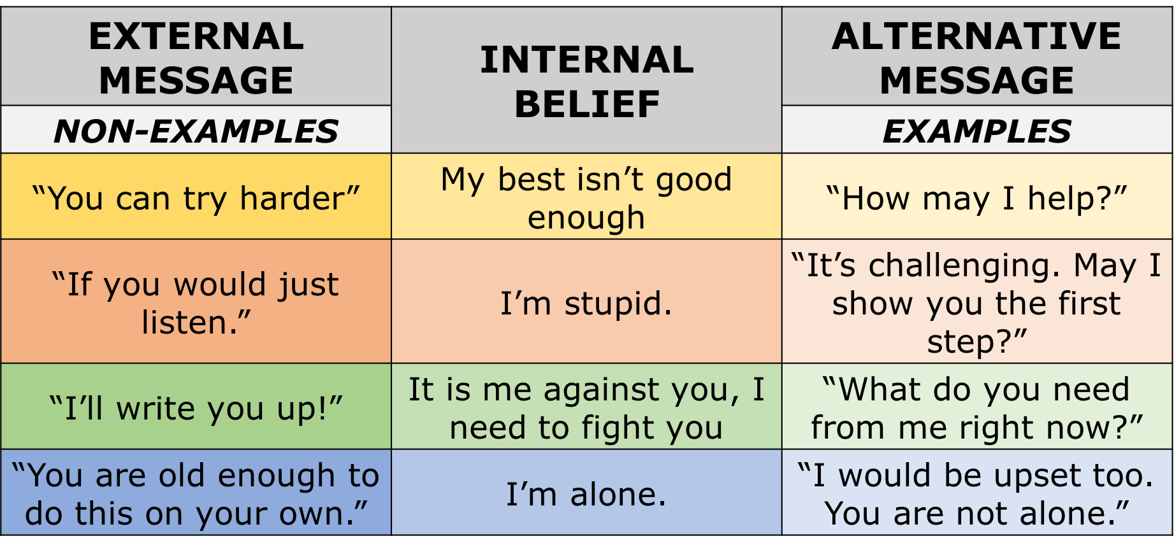
External Message: Internal Belief
Workbook 61

Slide 10
Let’s Practice: Chat Box
How would you rephrase this statement to be more trauma sensitive?
Non-example: Well, welcome back! You’ve been out so many days you’ve fallen behind in your work.
Write in the chat box an alternative message or an idea for redirection.

Slide 11
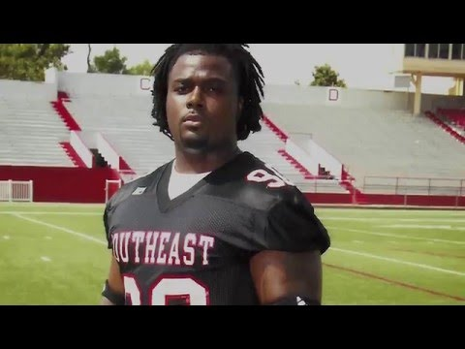
Your Words Matter

Slide 12
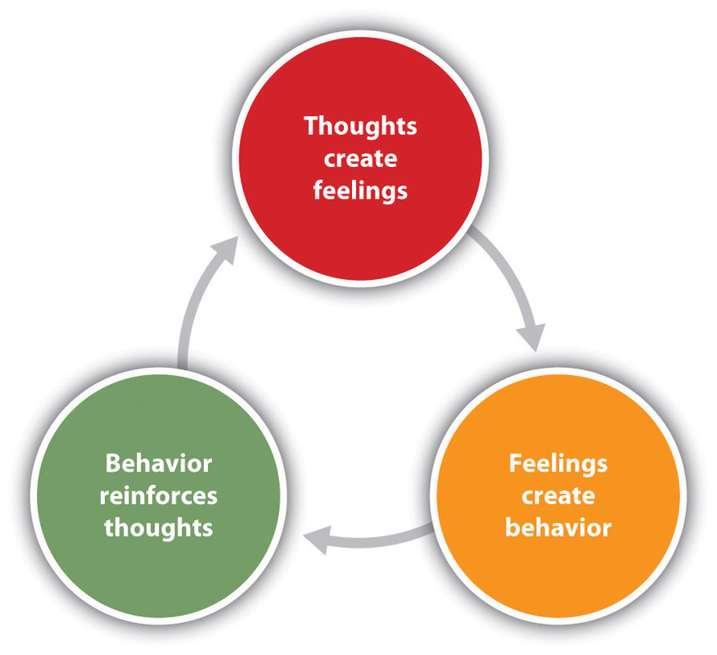
Thoughts, Feelings, Action:
Self Awareness, Self Management, Responsible Decision Making
I’m stupid! I always get bad grades.
Student has feelings of frustration
Student shuts down and refuses to do work.
Dr. Aaron Beck

Slide 13
Non-examples: Error Corrections
How many times do I have to tell you to work quietly?
Didn’t I just tell you to get your work done?
Why are you talking when I’m talking?
Do you want me to send you to the office?
What’s going to happen if I call your mother?
What do you think you’re doing?
Don’t you think you should be using your time better?

Slide 14
Digging Deeper
Self-affirmations
Value-Based Affirmations
Classroom Mantras
(Christopher N. Cascio Matthew Brook O’Donnell Francis J. Tinney, Matthew D. Lieberman Shelley E. Taylor Victor J. Strecher Emily B. Falk)
(Valerie Purdie-Vaughns, Geoffery L. Cohen, Julio Garcia, Rachel Sumner, Jonathan C. Cook & Nancy Apfel — September 23, 2009)
(Carnegie Mellon University’s David Creswell)

Slide 15
Affirmations in Action

Slide 16
What did you notice?
What did you notice in the video that supported what you’ve been learning throughout your work with VTSS?

Slide 17
Behavior Specific Praise with an affirmation!
Behavior: Student comes in a gets right to work on the morning assignment
Teacher: The teacher uses behavior specific praise paired with a PRIDE slip:” You are showing great responsibility by coming in to class and getting right to work” (PRIDE slip is given and will be dropped into the PRIDE mailbox to enter the student in the weekly drawing.)
Student: when given the PRIDE slip says the self-affirmation: “I am responsible!”

Slide 18
Examples: Self-Affirmations
Self-Confidence
“I refuse to believe I am stupid any longer. I am capable and I accept that now.”
Emotional
“I refuse to believe I am bad. I can make mistakes and learn, and I accept that now.”
Social
“I refuse to believe I am disliked. I can learn to make friends and accept that now.”

Slide 19
Value-Based Affirmations
When we engage in individually examining our values and learning to become self-aware within this recognition, research has found we do a better job at regulating our emotions, problem solving, and dealing with stress. It also helps with self-identity and a sense of belonging.
https://ed.stanford.edu/sites/default/files/annurev-psych-psychology_of_change_final_e2.pdf
https://www.cmu.edu/homepage/health/2013/summer/benefits-of-self-affirmation.shtml

Slide 20
Classroom Mantras
Preemptive work needs to be done
Practice and repeat prior to behavioral challenges
Repetition
How could you use mantras in your virtual setting?

Slide 21
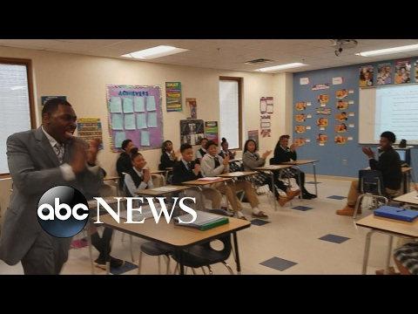
Mantra: Classroom

Slide 22
Mantra: Schoolwide

Slide 23
School wide Acknowledgement Matrix
TYPE | WHAT | WHEN | WHERE | WHO
Immediate/High Frequency In the moment, predictable, Delivered at a high rate for a short period (e.g., Gotchas, Paws, High Fives) | STUDENT: ADULTS | High frequency for a short time when first teaching desired behavior or re-teaching identified problem behavior from data |  | ALL STUDENTS, ALL ADULTS
Redemption of high frequency (e.g., school store, drawings) | STUDENTS: ADULTS: | At least monthly |  | ALL STUDENTS, ALL ADULTS
Intermittent/Unpredictable (e.g., surprise homework completion treat, random use of gotchas in hallway) | STUDENTS: ADULTS: | Maintaining a taught behavior (fading) |  | ALL STUDENTS, ALL ADULTS
Long-term School-wide Celebrations (school-wide not individually based) FOR: Ex: ODR reduction, school-wide target met for certain setting/behavior area ACTIVITY: (e.g., ice cream social, dance, game day) | BOTH TOGETHER: | At least quarterly |  | ALL STUDENTS, ALL ADULTS
Workbook 66-67

Slide 24
School wide Acknowledgement Matrix Continued
How can you incorporate affirmations and mantras?
How can you include a TSS lens in your School-Wide Acknowledgement Matrix?
List some ideas for your division and school.

Slide 25
Division Recognizing Staff School Example
http://heartofhenrico.henricoschools.us/

Slide 26
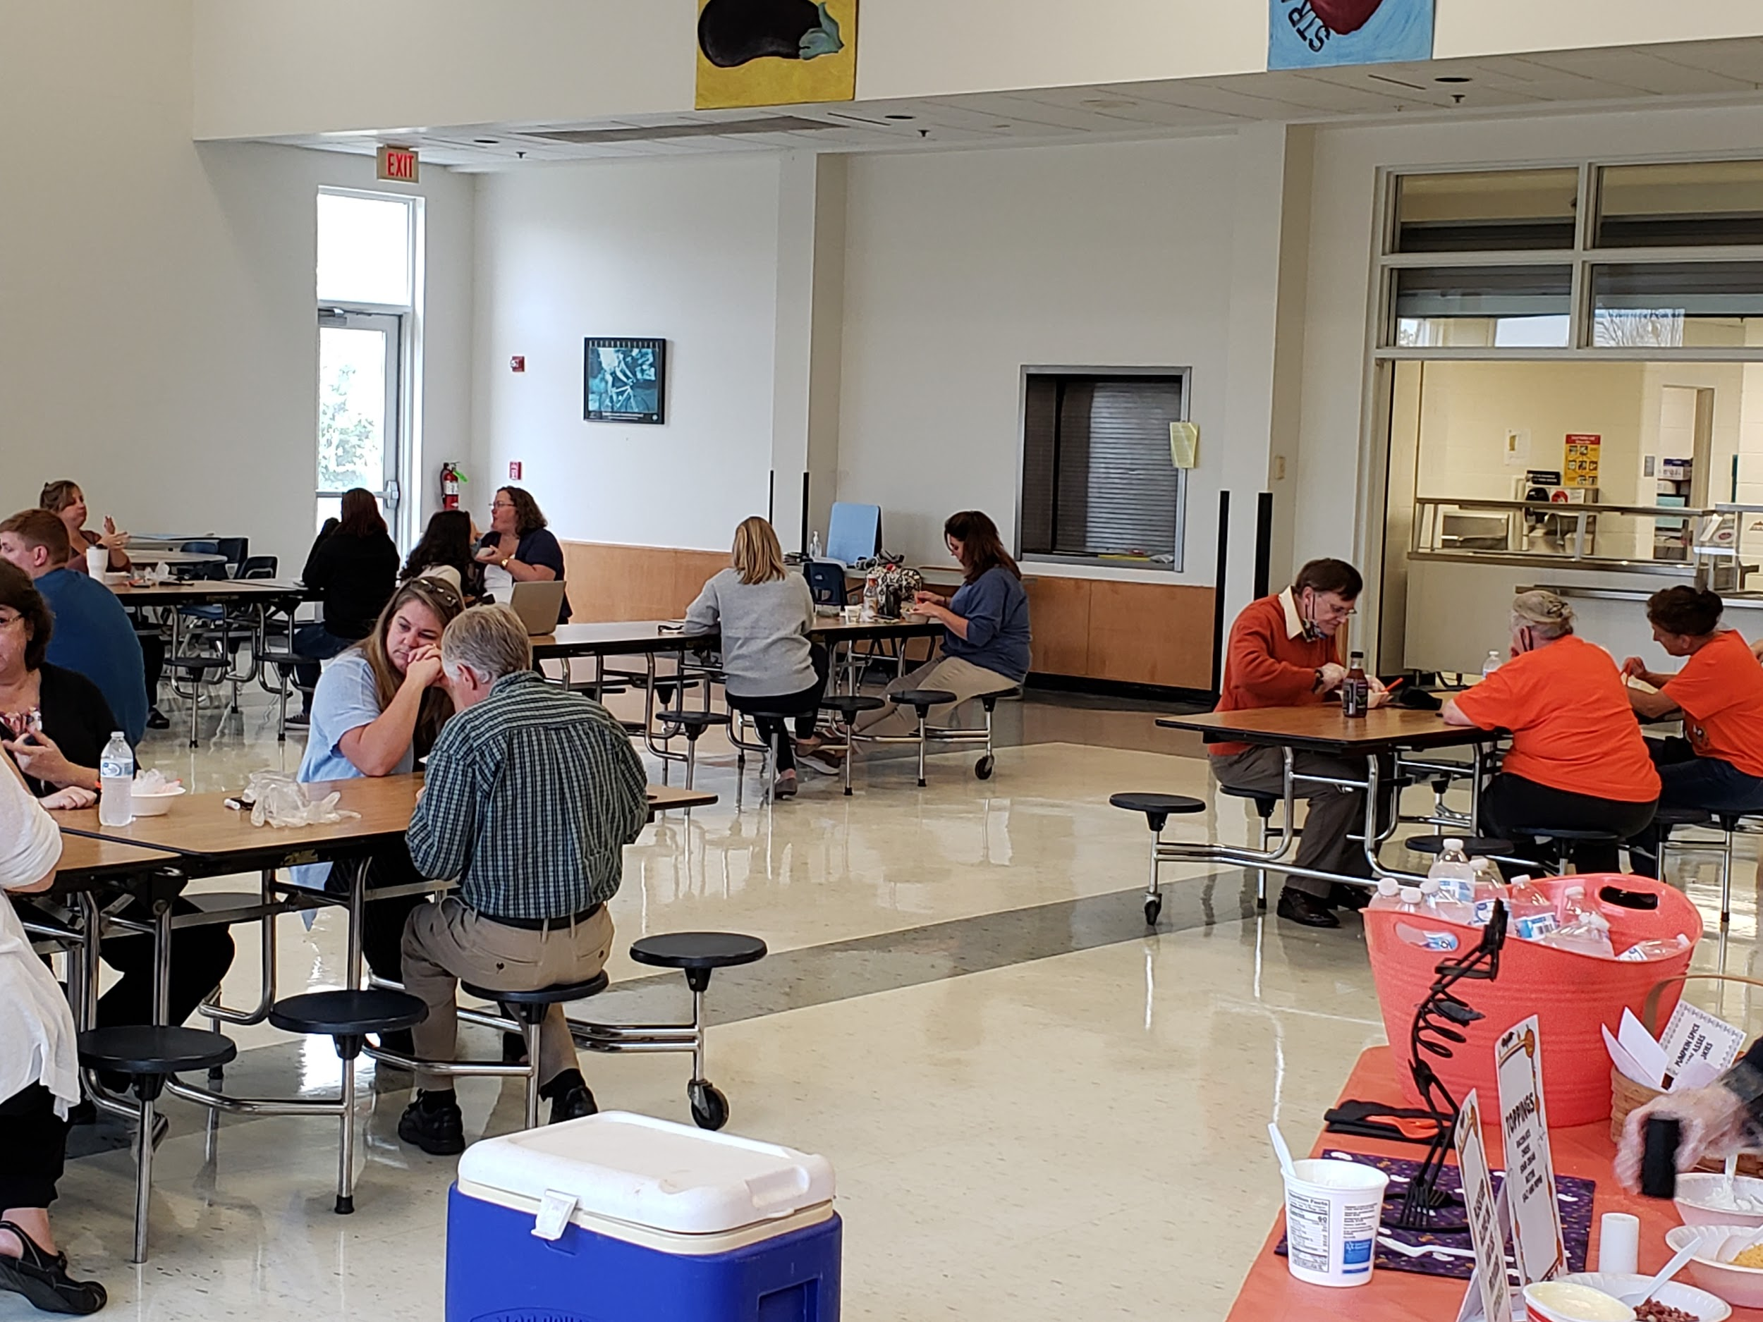
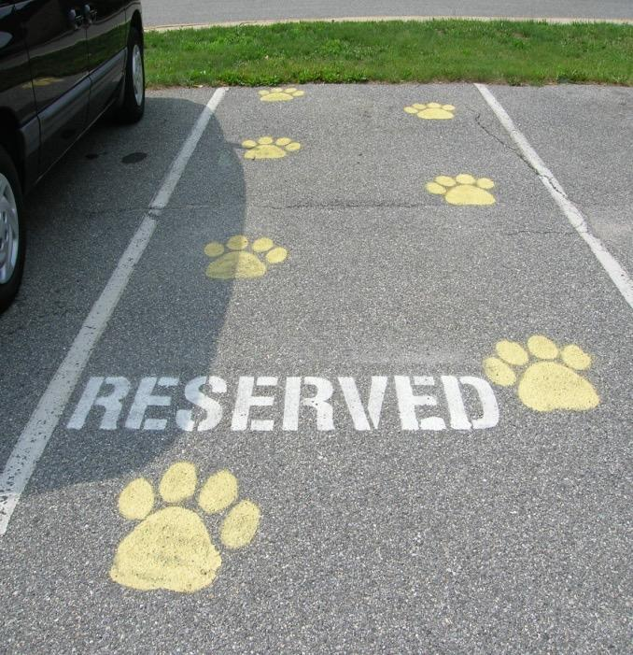
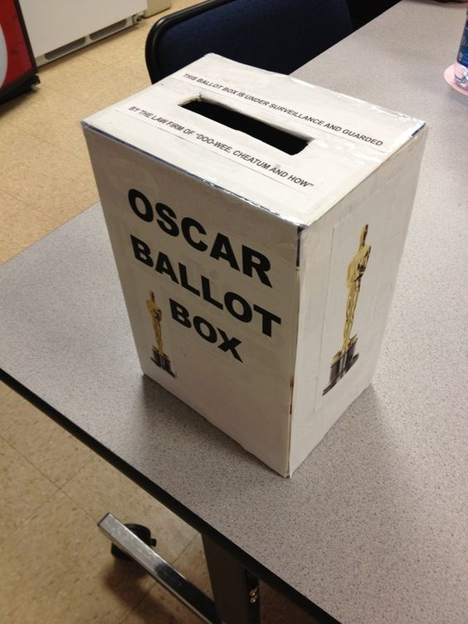
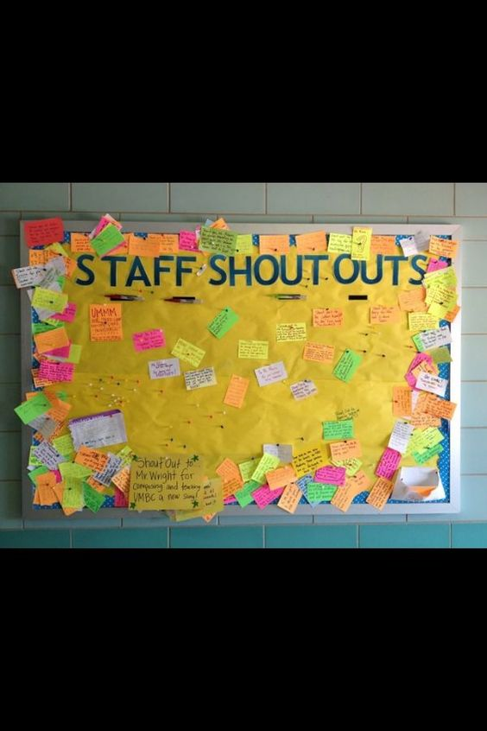
Administrators Recognizing Staff
Keep staff motivated and appreciated!
Use community resources and local businesses
Incentives for staff could include:
Tangibles
Tokens
Symbolic
Celebrations
Rockfish Elementary, Nelson Public Schools
BOOpatato Bar! (10/2020)

Slide 27
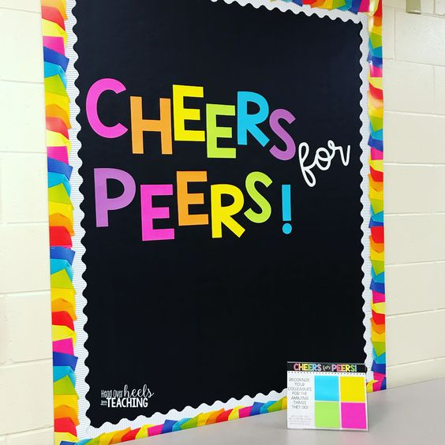
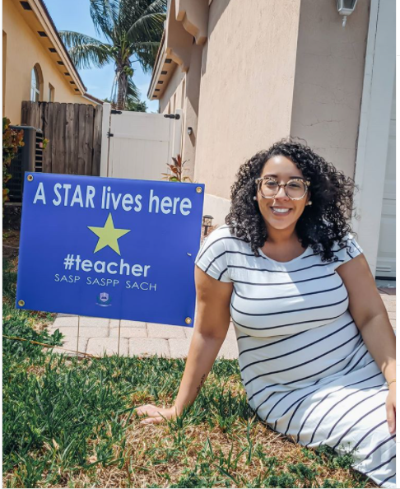
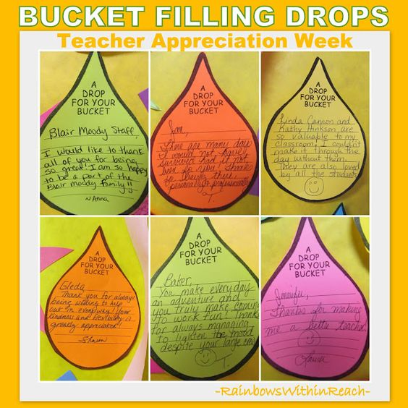
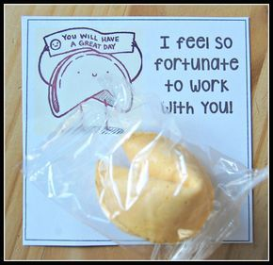
Staff Recognizing Staff

Slide 28
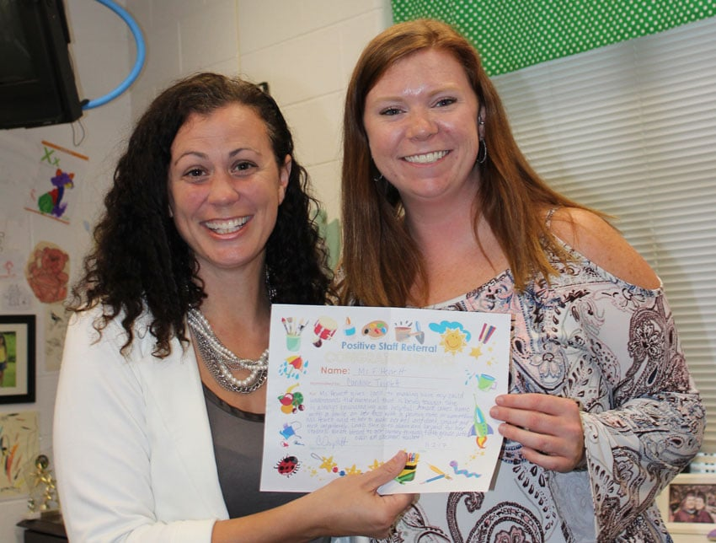
Students Recognizing Staff

Slide 29
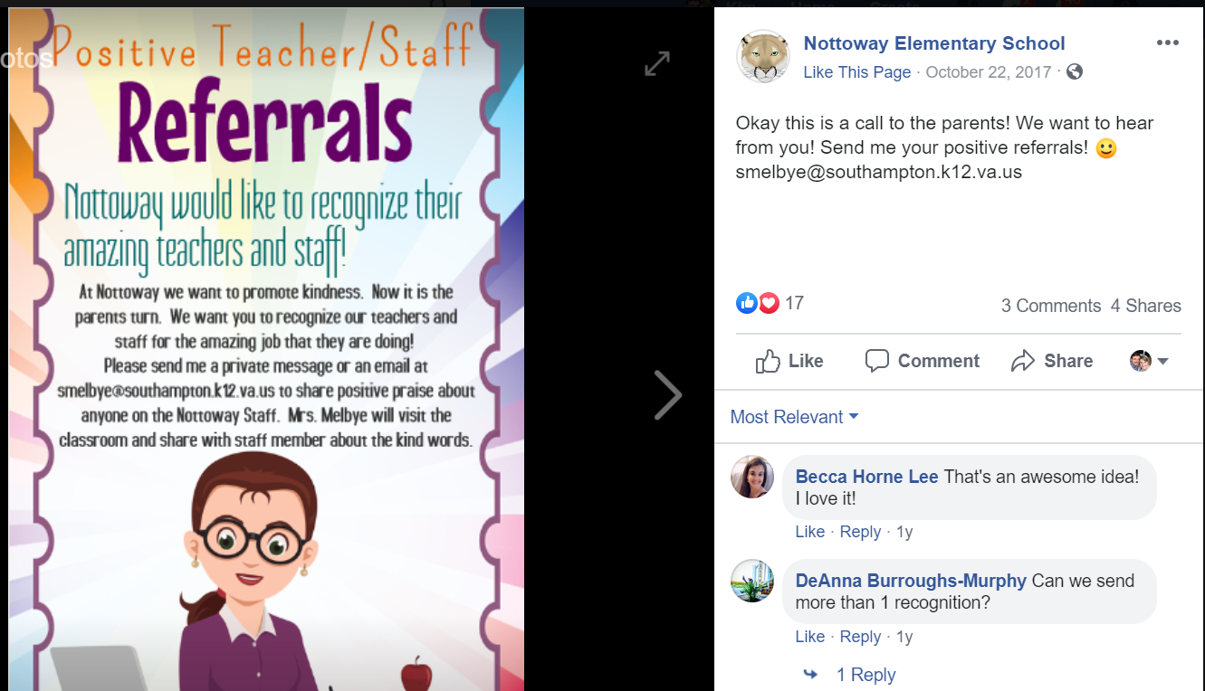
Families Recognizing Staff

Slide 30
Schools Recognizing Families
Making sure we have the voice of all families; when you listen I feel recognized
Creating a warm welcome from the moment they walk into your building (office staff, greeting them)
Have a “red carpet” celebration of our families at meetings or a special event for families
Recognize needs and provide for families (babysitting night, ELL night with interpreters and fun activities, a cultural night)
Honoring the contributions of families
Food, socializing, events in which students are involved build a sense of community
Reaching out in positive ways (positive phone calls home, Facebook or social media, automated call system messages)

Slide 31
Share YOUR ideas!
Please go to Padlet and share your practices for acknowledging staff and families!
Make sure you have a recorder and facilitator!

Slide 32
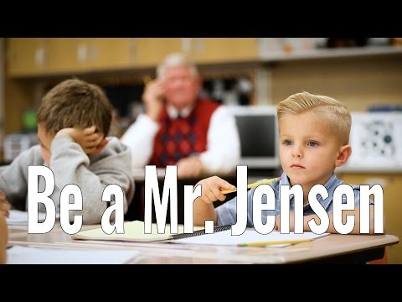
Be a Mr. Jensen

Slide 33
Action Planning
Are we acknowledging our staff, students, and families?
Do we have some new ideas of how we can add to what we are already doing?

Slide 34
Resources
Help for Billy: A Beyond Consequences Approach to Helping Challenging Children in the Classroom
ASCD, Nancey Frey
Christopher N. Cascio Matthew Brook O’Donnell Francis J. Tinney, Matthew D. Lieberman Shelley E. Taylor Victor J. Strecher Emily B. Falk
Valerie Purdie-Vaughns, Geoffery L. Cohen, Julio Garcia, Rachel Sumner, Jonathan C. Cook & Nancy Apfel — September 23, 2009
Carnegie Mellon University’s David Creswell

Slide 35
Resources Continued
Thoughts, Feelings, Behaviors: Dr. Aaron Beck
Resource: https://beckinstitute.org/get-informed/what-is-cognitive-therapy/
How to still make teacher appreciation special, virtually.

