Slide 1
Trauma Sensitive Schools within VTSS
TFI 1.3 Behavior Expectations
TFI 1.8 Classroom Procedures

Slide 2
What We Will Know and Do – 1.3
Understand social emotional competencies and how to embed those within the matrix.
Action Plan: School-wide matrix to include social emotional competencies.

Slide 3
1.3 Behavioral Expectations
TFI: School has five or fewer positively stated behavioral expectations and examples by setting/location for student and staff behaviors (i.e., school teaching matrix) defined and in place.
Mental Health Planning Tool: The school teaching matrix includes social-emotional skills.
A-TFI: Evidence-based curricula are organized into clearly defined
learning objectives and progressions that are aligned to state standards.

Slide 4
Our Curriculum?
We develop these common expectations through the common practice of developing the teaching matrix.
Consistent instruction across multiple programs and settings within the school
Communication among staff members and students
Students know what to expect and what is expected in all areas
Consistent communication with parents
Makes the “hidden curriculum” visible

Slide 5
Specific Behaviors/ Social-Emotional Skills
BE SAFE: Keep hands and feet to self
BE SAFE: Tell an adult when I am worried about a friend.
BE RESPECTFUL: Use the signal to ask a public or private question
BE RESPECTFUL: Make sure everyone gets a turn
BE RESPONSIBLE: Turn in all work on time
BE RESPONSIBLE: Check in with my feelings during the day.

Slide 6
Trauma Sensitive Thinking
Think: lack of skill, not intentional misbehavior
Think: building missing skills, not shaming for lack of skills
Think: nurture, not criticize
Think: teach, not blame
Think: discipline, not punishment

Slide 7
What If?
We…
are focused on specific ways that everyone teaches social emotional skills across ALL settings and content areas...everyday!!!
...and we use our data to prioritize the skills we teach….

Slide 8
Installing SEL curricula within the Framework of VTSS
What does the data say? (community demographics, screening info. attendance patterns, discipline patterns, climate surveys, family members deployed, family members impacted by drug use, domestic violence, calls to crisis centers, etc.)

Slide 9
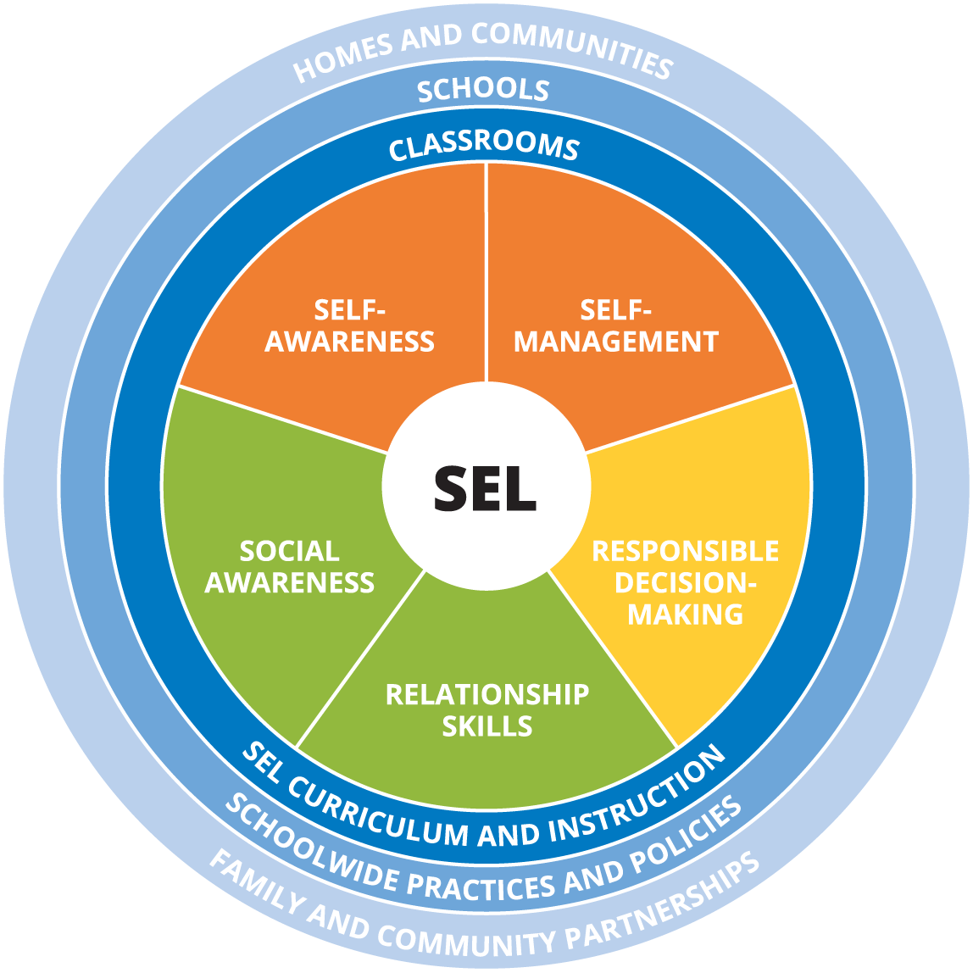
Social Emotional Competencies

Slide 10
Focus on Social Emotional Skills
Please see your VTSS Systems Coach for the video

Slide 11
SEL Competencies
Self-Awareness - Recognize one’s own feelings, interests, strengths and limitations
Self-Management - Regulate emotions and manage daily stressors
Social Awareness - Take perspective of others and appreciate similarities and differences
Relationship Skills - Exhibit pro-social behavior and demonstrate positive social skills in order to develop meaningful relationships
Responsible Decision Making - Make ethical decisions and strengthen the ability to develop appropriate solutions to identified problems

Slide 12
How do we include social- emotional skills in our matrix?
Identify locations where you can teach SEL in your ALREADY EXISTING lesson plans
Embed in current matrix
Add an expectation around trauma
Be Resilient
Be Resourceful
Be Supportive
Be Inclusive
Add a “SELF” column/location

Slide 13
Matrix: Review matrix/lesson plans
TEACHING MATRIX | All Settings | Classrooms | Hallways | Cafeteria
RESPECT | Be kind Hands/feet to self Help/share with others | Give your best effort | Use normal voice volume | Practice good table manners
RESPONSIBLE | Recycle Clean up after self | Participate in activities | Walk | Replace trays & utensils
SAFE | Be alert to your surrounding | Follow adult instructions | Maintain physical space | Clean up eating area

Slide 14
Matrix: Specific Behaviors
SETTING > | All Settings | Classrooms | Hallways | Cafeteria
RESPECT | Be kind Hands/feet to self Help/share with others | Give your best effort USE POSITIVE SELF-TALK | Use normal voice volume | Practice good table manners
RESPONSIBLE | Recycle Clean up after self USE CALMING STRATEGIES | Participate in activities MONITOR FEELINGS/ EMOTIONS | Walk | Replace trays & utensils
SAFE | Be alert to your surrounding | Follow adult instructions ASK FOR HELP | Maintain physical space | Clean up eating area

Slide 15
Matrix: Core Value
SETTING > | All Settings | Classrooms | Hallways | Cafeteria
RESPECT | Be kind Hands/feet to self Help/share with others | Give your best effort | Use normal voice volume | Practice good table manners
RESPONSIBLE | Recycle Clean up after self | Participate in activities | Walk | Replace trays & utensils
RESILIENT | IDENTIFY EMOTIONS USE COPING STRATEGIES | ASK FOR HELP | COMMUNICATE IF THERE IS A PROBLEM | USE RELAXATION STRATEGIES

Slide 16
Matrix: “Self” Column
SETTING > | All Settings | Classrooms | SELF | Hallways | Cafeteria
Respect | Be kind Hands/feet to self Help/share with others | Give your best effort | USE POSITIVE SELF-TALK | Use normal voice volume | Practice good table manners
Responsible | Recycle Clean up after self | Participate in activities | MONITOR FEELINGS/ EMOTIONS USE CALMING STRATEGIES | Walk | Replace trays & utensils
Safe | Be alert to your surrounding | Follow adult instructions | ASK FOR HELP | Maintain physical space | Clean up eating area

Slide 17
Action Planning - 1.3
Review your current matrix
Make a list of social-emotional skills you want to prioritize
Identify places where you can teach social-emotional skills within your current matrix
If you are using an SEL curriculum for Tier 1, how can you align the lessons/language with your matrix?
What next steps do you need to take to update or revise your matrix?

Slide 18
Trauma Sensitive Schools within VTSS
TFI 1.8 Classroom Procedures

Slide 19
What We Will Know and Do – 1.8
Understand the importance of relationships for students who have experienced trauma
Identify strategies to foster the development of positive relationships between all stakeholders
Gain an understanding of how trauma can impact students in the classroom
Explore key classroom practices and understand how the practices support students impacted by trauma
Action plan around classroom practices as well as stakeholder communication

Slide 20
1.8 Classroom Procedures
TFI: Tier 1 features (school-wide expectations, routines, acknowledgements, in-class continuum of consequences) are implemented within classrooms and consistent with school-wide systems.
Mental Health Planning Tool: Educators are knowledgeable of and use strategies that promote SEL and relationships between educators and student, student to student, educators to educators and connections between children and families and schools.
A-TFI: Evidence-based practices and routines are implemented with fidelity and consistency across all classrooms (e.g. activating prior knowledge, explicit instruction, engagement, feedback, scaffolding).

Slide 21
Relationships
We know the research from Hattie around relationships shows an effect size of .73 on student achievement, thus relationships are the key to success in the classroom, especially for students who have experienced trauma.

Slide 22
Importance of Relationships
You can obtain a copy of this video through your VTSS Systems Coach.

Slide 23
It all starts with Relationships
Activity:
Using the padlet, list practices/activities that you use to support building positive relationships between staff, leadership, students and families.

Slide 24
Ways to Connect
Two by Ten - for ten days in a row, spend two minutes talking to a student about anything except school
Daily Check-in and Check-outs - brief interaction between student and an adult
Community Building circles - use a circle format to get to know one another in the classroom, discuss topics, have shared experiences.

Slide 25
Importance of other connections
Student - Student
Staff - Staff
School - Family
Leadership - Staff

Slide 26
Trauma in the Classroom
“For many children who have experienced traumatic events, the school setting can feel like a battleground in which their assumptions of the world as a dangerous place sabotage their ability to remain calm and regulate their behavior in the classroom.”

Slide 27
How Does Trauma Impact Students in the Classroom?
Executive Functioning
Language and Communication Skills
Memory
Ability to see Cause and Effect
Organizational Ability
Concentration and Attention
Descriptions that follow largely based on Rodenbush, K. (2015). The effects of trauma on behavior in the classroom included in Education Northwest “A Practitioner’s Guide to Educating Traumatized Children”

Slide 28
VTSS Top 10
Physical Environment
Active Supervision
Define Classroom Expectations
Routines and Procedures
Opportunities to Respond
Formative Assessment
Scaffolding
Acknowledgement and Behavior Specific Praise
Error Correction
Building Community Through Feedback

Slide 29
Physical Environment
Provide a sense of safety, calm, and security
reduce triggers
create welcoming
space

Slide 30
Considerations
Improve Lighting: use small lamps, fluorescent covers, dinner switch
Reduce Noise: tennis balls on chairs
Improve visuals: post positive messages, reduce clutter, consider furniture arrangement and traffic patterns, use agendas
Bring in Nature: have plants, use a water feature, have pictures of landscapes and nature
Establish Calming Areas: quiet space, chair, sensory materials

Slide 31
Establishing a Sense of Safety
Focus on positive relationships
Practice active supervision
Incorporate a class meeting structure
Define, teach, and acknowledge appropriate behavior
Class expectations and norms
Establish routines and procedures that support Social Emotional Learning

Slide 32
Classroom Matrix
TEACHING MATRIX |  | SETTINGS
 |  | All Settings | Classrooms | Hallways | Cafeteria
E X P E C TAT I ONS | Respect | Be kind Hands/feet to self Help/share with others | Give your best effort USE POSITIVE SELF-TALK | Use normal voice volume | Practice good table manners
 | Responsible | Recycle Clean up after self USE CALMING STRATEGIES | Participate in activities MONITOR FEELINGS/ EMOTIONS | Walk | Replace trays & utensils
 | Safe | Be alert to your surrounding | Follow adult instructions ASK FOR HELP | Maintain physical space | Clean up eating area

Slide 33
Considerations for Routines and Procedures to support SEL
Manage stress
Celebrate differences
Emotional check-ins
Explore various cultures and perspectives
Group and individual problem solving

Slide 34
Classroom Matrix: Routines
Classroom Procedures
SETTING > | SMALL GROUP INSTRUCTION | HOW TO ASK FOR HELP | WHEN I FEEL UPSET/ FRUSTRATED
RESPECT | LISTEN TO PEERS WHEN THEY SPEAK USE KIND WORDS | RAISE HAND OR USE PRIVATE SIGNAL TO GAIN TEACHERS ATTENTION | COMMUNICATE WITH TEACHER/ADULT USE KIND WORDS
RESPONSIBLE | KEEP UP WITH YOUR MATERIALS | WAIT FOR TEACHER ACKNOWLEDGEMENT | IDENTIFY EMOTION
SAFE | WALK WHEN MOVING AROUND THE CLASSROOM | USE QUIET VOICE | USE COPING STRATEGY

Slide 35
Action Planning – 1.8
How will you facilitate the development of positive relationships with all stakeholders?
What will you add/change to your classroom practices to make them more trauma sensitive?

