Slide 1
Trauma Sensitive Schools within VTSS
TFI 1.6 Discipline Policies

Slide 2
What we will know and do
As a result of this learning, participants will…
Gain an understanding to the changes to the Model Code of Conduct and how they are trauma sensitive
Define and identify personal vulnerable decision points in order to effectively respond
Incorporate a trauma sensitive lens into responses to interfering behavior

Slide 3
1.6 Discipline Policies
TFI: School policies and procedures describe and emphasize proactive, instructive, and/or restorative approaches to student behavior that are implemented consistently.
Mental Health Planning Tool: The school’s policies and procedures include an explicit focus on Social Emotional skill development and well-being of students and are implemented consistently.

Slide 4
Model Code of Conduct
Updated 2019
Prevention focus
Tiered systems
Social-Emotional skills
Restorative questions
Leveled responses

Slide 5
Recommended Practices
Explicitly taught clear behavioral expectations
Explicitly taught SEL skills
Positive reinforcement of behavior
Restorative practices to build relationships
Family engagement
Relationships that foster trust and build protective factors

Slide 6
Before we respond...
Let’s reflect on our
own behavior....
setting events
antecedents

Slide 7
Vulnerable Decision Points (VDP)
A VDP is a given situation coupled with a person's internal state that increases the likelihood of bias affecting discipline decision making.

Slide 8
Situations
Subjective problem behavior
Defiance, Disrespect, Disruption
Major vs. Minor
Non-classroom areas
hallways, cafeterias
Classrooms
Afternoons

Slide 9
Decision States
Setting Events - an event occurring before or with an antecedent that increases the likelihood of a behavior
Resource Depletion - as we become fatigued, our filters for appropriate behavior can be affected

Slide 10
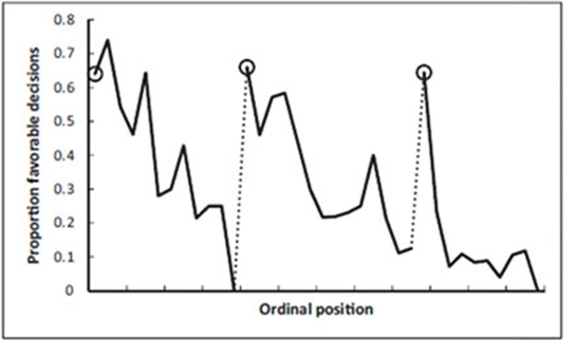
Example: Resource Depletion
Outcomes of parole hearings
(Danziger et al. 2011)

Slide 11
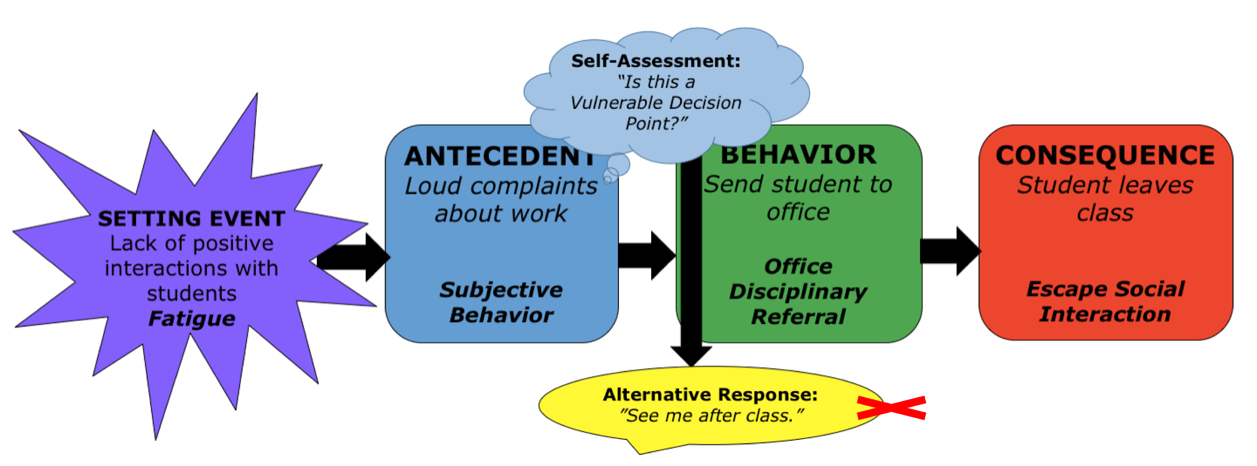
Neutralizing Routines

Slide 12
Critical Features of Neutralizing Routines
If-then statement
Brief
Clear steps
Doable
Interrupts the chain of events

Slide 13
Recognizing Our Potential
“Punitive discipline is reduced when educators are taught to perceive acting-out behavior through the lens of psychological and emotional dysregulation.”
(Micere Keels, Educational Leadership, Oct. 2020)

Slide 14
Team Time
Think about the concepts of vulnerable decision points and neutralizing routines.
Are there things you need to consider with your own practices?
How can you share this information with your staff?

Slide 15
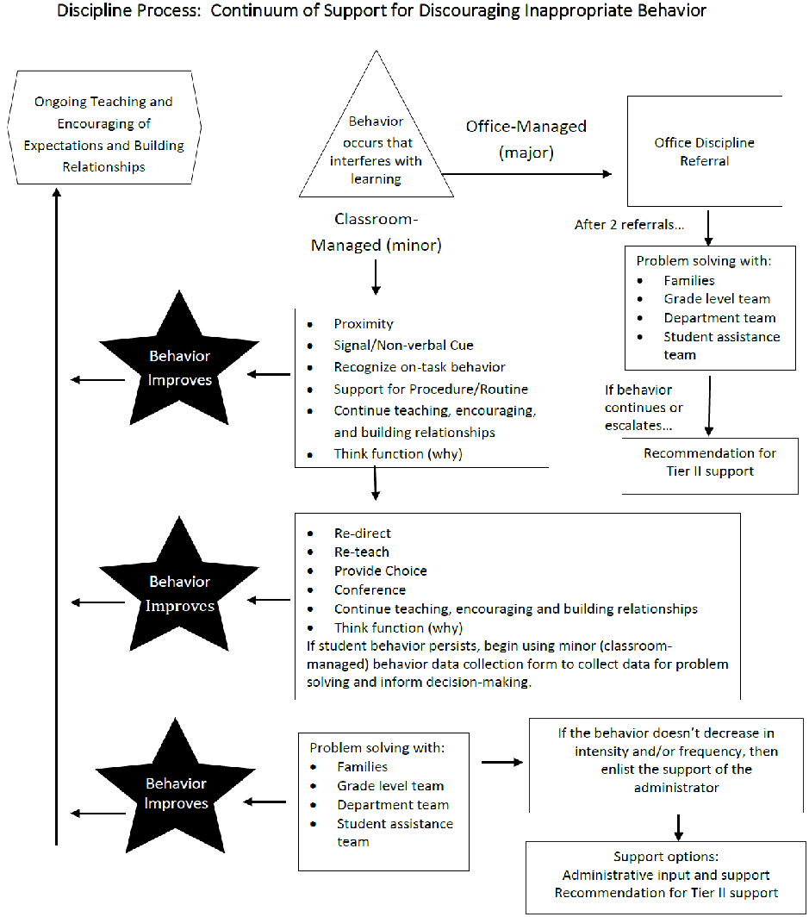
Response to minor behavior
Classroom Strategies for Minor Behavior

Slide 16
Responding vs. Reacting

Slide 17
Under the Surface
We do not get to decide what is stressful or traumatic for someone else.
Please see your VTSS systems coach for the video.

Slide 18
Know the story
What else is really going on here?
What does this child need?
How can I change my perspective?
What keeps me only looking at the behavior?
What is this behavior communicating right now?
What in the environment could be triggering this behavior?

Slide 19
Needed Perspective Shift
Traditional view:
“What’s wrong with you?”
“Why did you do that?”
Perspective Shift:
“How can I help, what happened?”
“What do you need?”

Slide 20
Perspective Shift Example
Instead of he’s attention seeking, “Why isn’t he getting attention in the way most of his peers do?”
Instead of she’s avoiding, “Many of us avoid when we are emotionally uncomfortable… why is she uncomfortable?”
Instead of they want control, “Why can’t they get their wants & needs met without conflict?”
Instead of she has a trauma history, “If exposure to ACE changes brain architecture, what skills might she need help with?”

Slide 21
Strategies

Slide 22
Remember the Goal
“When everyone handles infractions with instructional correction procedures, students learn that what happens when they misbehave is procedure not personal.”
Bob Algozzine
Q-TIP

Slide 23
Connection before Correction
Conference with student
Use encouraging language

Slide 24
Validation
In the moment,
Don’t try to fix it.
Don’t give a life lesson or lecture.
Try using Validating Statements:
What can I help you with?
What do you need to feel safer?
I hear you, that sounds hard.
How did that make you feel?
It sounds like you are really struggling.

Slide 25
Prompt the use of SEL skills
Self-Awareness
Self- Management
Social Awareness
Relationship Skills
Responsible Decision Making

Slide 26
Offer Choices
Allows student to have
some control over the
situation
Often de-escalates the situation
Only offer choices you are willing to accept

Slide 27
Calm Spaces

Slide 28
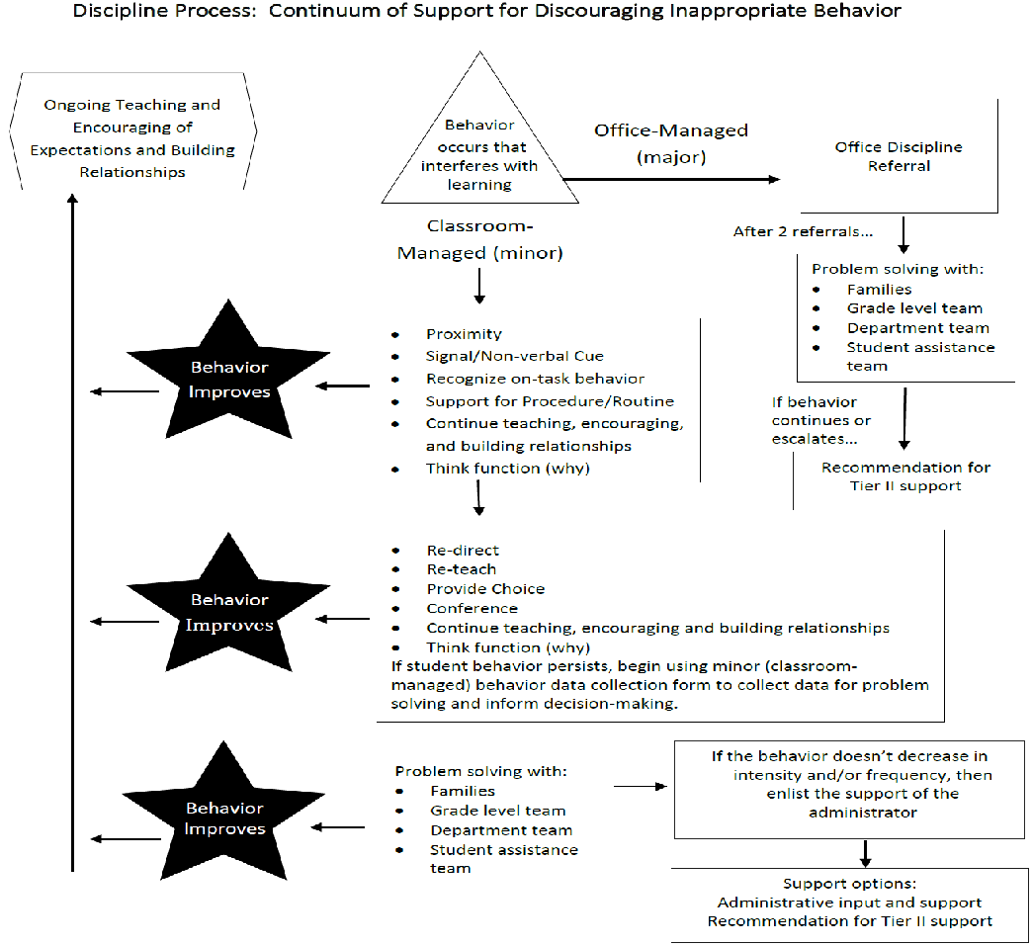
Sometimes, the decision takes us here...

Slide 29
What is the goal?
Is the goal to apply a consequence, change the student behavior or teach appropriate behavior?
The course of action that you choose should result in reaching that goal.
Consistency is key, not severity.

Slide 30
Discipline
Alignment with SEL and TSS
Clear limits and boundaries
Context of continued relationship
Restore the harm, return to the community
Provide rational detachment
Involve natural supports
Consider institutional bias

Slide 31
Alternatives to Exclusionary Practices
problem solving/contracting
restitution
mini-course or skill modules
parent involvement/supervision
counseling
community service
behavior monitoring
coordinated behavior plans
alternative programming
in-school suspension

Slide 32
Example
Please see your VTSS systems coach for the video.

Slide 33
Final Thought
Schools can no longer limit interventions to individual children with known trauma histories, but must create instructional frameworks that integrate a trauma-sensitive approach into all aspects of the school day.
Susan Craig - Reaching and Teaching Children who Hurt

Slide 34
Action Planning with Team
Consider what trauma-sensitive adjustments or enhancements to your school’s discipline policies and procedures (including an explicit focus on Social Emotional skill development) to ensure well-being of students.

