Slide 1
Trauma Sensitive Schools within VTSS
TFI 1.4 Teaching Expectations

Slide 2
What we will know and do
As a result of this learning, participants will...
understand and explain the rationale for teaching social-emotional competencies in a trauma sensitive approach.
explore and apply methods for teaching SEL
review lesson plans inclusive of social emotional competencies to teach your schoolwide expectations and non-classroom specific behaviors and procedures.
plan and schedule for lessons across school-wide, non-classroom and classroom settings.

Slide 3
Roadmap
TFI | Mental Health Planning Tool | A-TFI
1.4 Teaching Expectations: Expected academic and social behaviors are taught directly to all students in classrooms and across other campus settings/locations. | 1.4 Teaching Expectations: Social-emotional skills are explicitly taught as well as embedded across the curriculum. | 1.4a Evidence Based Practices: Teachers strategically select and use evidence-based practices that are supported by the division/school and matched to learner needs 1.4b Lesson Plans: A process for lesson plan development includes the knowledge, skills and cognitive levels matched to student success criteria of the objectives in the curriculum.

Slide 4
Poll the Crowd #1
Which statements reflects teams use of SEL?
Our team has embedded SEL instruction within our existing Tier 1 practices.
Our Tier 1 team is using a specific curriculum to teach social skills, SEL or life skills.
Our Tier 1 team is exploring alignment or a potential SEL curriculum.
Our Tier 1 team has not yet considered aligning SEL curriculum.

Slide 5
Poll the Crowd #2
Who is responsible for implementing SEL in your school?
Counseling Department
PBIS Team
Student Support Team
Community Provider
All Staff
Instructional Staff
Other

Slide 6
Why teach SEL
Increase
Decrease
Academic Performance
Self-confidence
Behavior outcomes
Positive Attitudes toward school and interactions with other
Teacher confidence
Self-efficacy
Job satisfaction and well-being
Student aggression
Emotional distress of students
Perceived stress of teachers
Durlak et al., 2011

Slide 7
Deeper Dive

Slide 8
School-wide Approach
We want to move from a small number of staff delivering lessons to all staff providing opportunities to teach in all settings, all day.

Slide 9
Alignment
The same process for teaching SEL is the same process used for academics and behavior.

Slide 10
How? …Same Process
DEFINE
(TELL)
Simplify
ADJUST
(RETEACH)
For
efficiency
MODEL
(SHOW)
BE CONSISTENT
MONITOR
PRACTICE
In setting

Slide 11
SEL Approaches
SEL Approaches | Short Term Outcomes | Behavioral/Academic Outcome
Explicit SEL Skills Instruction Teacher Instructional Practices Integration with Academic Curriculum Areas Organizational, Culture, and Climate Strategies | SEL Skill Acquisition: Five Competence Areas | Positive Social Behavior
 | Improved Attitudes: Self, Others, Learning, and Schools | Fewer Conduct Problems
 |  | Less Emotional Distress
 | Enhanced Learning Environment: Supportive, Engaging, and Participatory | Improved Academic Performance

Slide 12
SEL and Equity
SEL advances educational equity and excellence through authentic school-family-community partnerships to establish learning environments and experiences that feature trusting and collaborative relationships, rigorous and meaningful curriculum and instruction, and ongoing evaluation. SEL can help address various forms of inequity and empower young people and adults to co-create thriving schools and contribute to safe, healthy, and just communities.
CASEL Updated Definition 2020

Slide 13
Culturally Responsive SEL Instruction
Teaching and learning practices recognize that there are multiple viewpoints and multiple constructive ways to reach various situations
It is important for teachers to recognize that some skills taught by SEL instruction could perpetuate the marginalization of students, emphasize compliant behaviors rather than addressing inequitable policies and practices in the school and classroom.

Slide 14
Culturally Responsive SEL Instruction Continued
Does not over-simplify what "appropriate" social and emotional responses are without exploring the complexities of social interactions.
Empowers students to constructively question inequitable treatment and make decisions that will move them toward self-determination.
Acknowledges and involves families and communities throughout the process

Slide 15
Student Voice
Please see your VTSS Systems Coach for a copy of this video.

Slide 16
Examples
Teaching Social Emotional Skills

Slide 17
3 Signature Practices
Please see your VTSS Systems Coach for a copy of this video.

Slide 18
Supporting SEL in the Classroom:
Examples
Seeing connections between current tasks and their personal goals and interests (self-awareness)
Developing skills for focusing attention and managing stress in order to effectively participate in learning (self-management)
Developing empathy and perspective-taking in their thinking, reading and writing processes (social awareness)
Developing speaking and listening skills for group collaboration (relationship skills)
Using writing to reflect on choices and goals as a way of making decisions (responsible decision making)

Slide 19
Determining Which Skills To Teach
Problem Behavior = |  |  | Inappropriate Language |  | Tardiness
Linked SW Expectation |  |  | Respectful |  | Responsible
 |  |  | Respectful |  | Responsible
What Does This Look Like? |  |  | Use words that are appropriate to express the sentiment (e.g., considerate, polite, kind, professional, etc.) |  | Be in class when the bell rings
How does this expectation benefit the classroom community (students and staff)? |  |  | Students and staff feel safe and comfortable in their environment; conflicts can be resolved |  | Learning isn’t disrupted; students are all able to participate in full lesson
Social and Emotional Skills to Teach |  |  | Stop-think-act Deep breaths Managing disappointment Making a complaint Reframing negative thoughts |  | Managing transition time Planning ahead Self monitoring Using conversation enders (e.g., ‘catch you later’)

Slide 20
Lesson Plan Examples
In your workbook you have examples of how to teach SEL.
Using your matrix from earlier start to create a lesson plan around your matrix including:
Define
Practice
Connection to Matrix
Monitor, Remind, Reteach

Slide 21
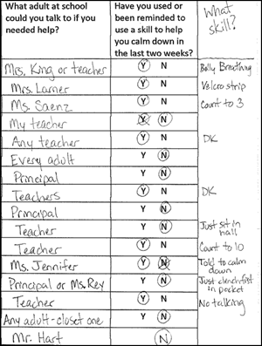
TFI Walkthrough Data

Slide 22
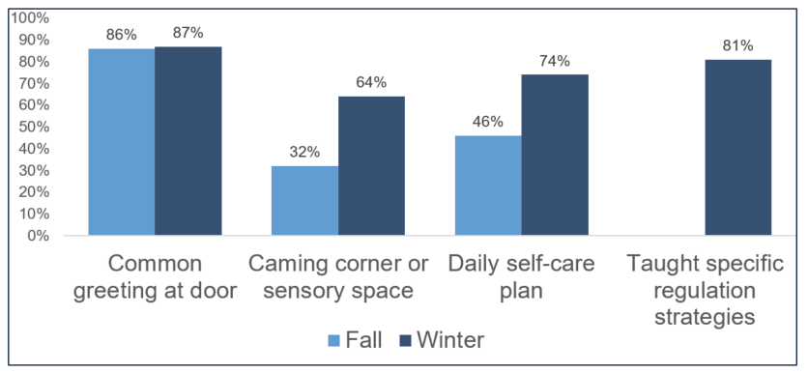
Staff Surveys: What Have You Implemented?

Slide 23
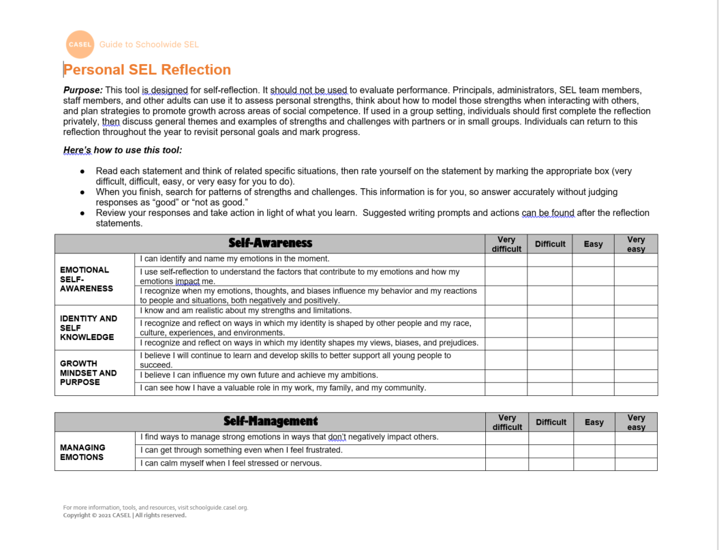
SEL Self Assessment

Slide 24
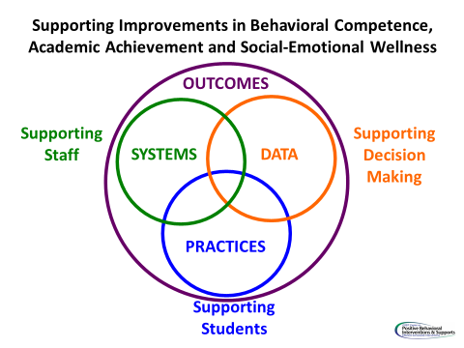
How do we support staff?
We want to develop the systems for supporting adults implementing SEL within the VTSS framework
Instructional approach
Data to get buy in and continuous improvement
Showcase effort and impact
Professional Learning should be team led, data-driven with coaching

Slide 25
Solutions
As a group, identify your solutions around teaching SEL:
Instruction
Staff buy-in
Professional Development
Talk about possible solutions as a group that you want to share out.

Slide 26
How and When to Teach SEL
Kick-off events
Teaching staff, students and families the expectations and rules
On-going Direct Instruction
Data-driven and scheduled designed lessons
Pre-correction
Re-teaching immediately after behavioral errors
Embedding into curriculum
Booster trainings
Scheduled and data-driven
Continued visibility
Visual Displays – posters, agenda covers
Daily announcements
Newsletters

Slide 27
Action Planning
How will you continue to embed and align SEL instruction into Tier 1 practices?
How and when will you teach the lesson?
How will use data to monitor progress?

