Slide 1
Trauma Sensitive Schools within VTSS
TFI 1.7

Slide 2
What We Will Know and Do
Apply a trauma sensitive lens to our system of professional learning & faculty involvement
Understand the components of resilience & hope
Learn the importance of relationships in building resilience to mitigate the effects of adverse childhood experiences

Slide 3
Roadmap
TFI | Mental Health Planning Tool | A-TFI
1.7 Professional Development: A written process is used for orienting all faculty/staff on 4 core Tier SWPBIS practices (a) teaching school-wide expectations (b) acknowledging appropriate behavior © correcting errors, (d) and requesting assistance. | 1.7 Professional Development The written process will include a plan to increase awareness and reduce mental illness stigma. Staff are trained in the following: a) the impact of social emotional and mental health issues on the whole child, b) recognition of signs and symptoms, c) appropriate and informed responses and/or referrals, and d) awareness of the array of services available in the community for students and families | 1.7 Professional Learning (a) A written process is used to provide high quality professional learning for faculty/staff on all quality core instructional and assessment practices 1.7 Coaching(b) Staff receive coaching in the planning, teaching, and assessment of the academic curricular 1.7 Collaborative Planning © Time for collaborative planning is in the schedule (including special education and resource staff) with accountability for the resulting instructional plan.

Slide 4
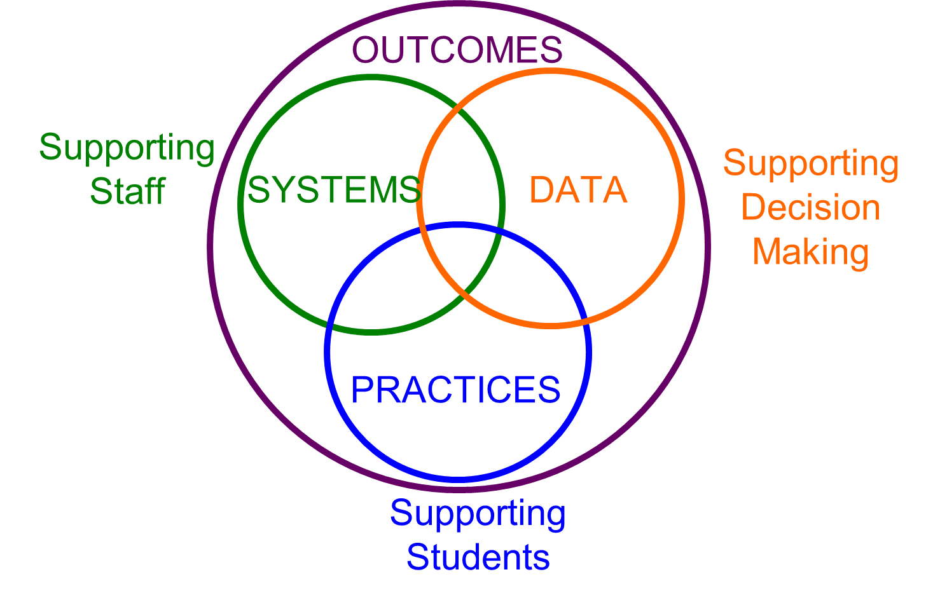
Attending to Adult Learning
Systems attend to adult learning
Implementation with fidelity is best achieved when the system intentionally creates learning and support for adults who are using the practices.

Slide 5
Key Considerations
Supporting staff development
Creating a safe and supportive environment
Assess needs and provide supports
Build strong social and emotional skills
Collaborate with students and families
Review policies and procedures

Slide 6
Professional Development
Develop PLO that outlines/supports the systems required for implementing practices
Using data to identify targeting trauma specific need(s)
Systems
Data
Practices
Selecting evidence-based practices that meets the trauma specific need(s)

Slide 7
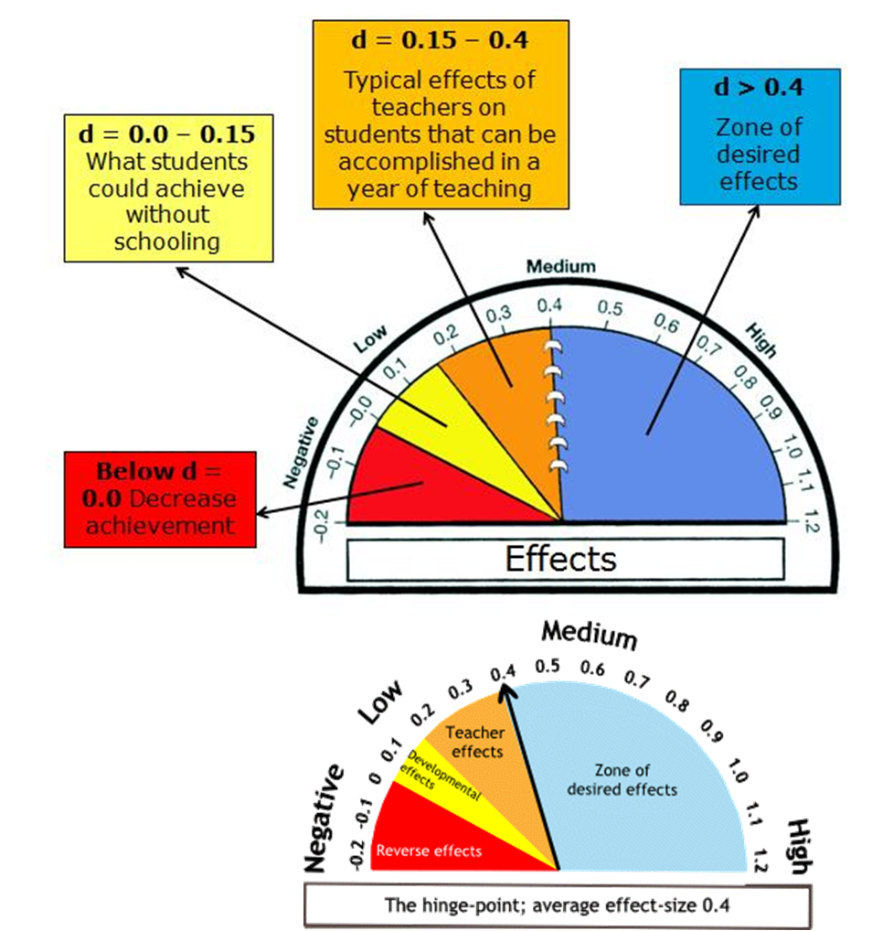
Suggestions for Getting Buy-in
Relate to your division and school goals
Use your data to lead the discussion
Assist administrators in supporting collective teacher efficacy to support the goal
Engage families and community in the partnership

Slide 8
Professional Learning
What makes professional learning effective?
How do we move towards out desired goals?

Slide 9
Professional Learning: School
Presentation of Theory and Research
Coaching and Follow up
Demonstration of the Strategy or Skill
Practice and Feedback

Slide 10
Important Areas of Focus
Understanding the prevalence and impact of trauma
Techniques for strengthening relationships between children and adults
Alternatives to punitive disciplinary practices
Academic and non-academic classroom strategies.
Creating a culture of wellness
TLPI: Helping Traumatized Children Learn-Lessons Learned.

Slide 11
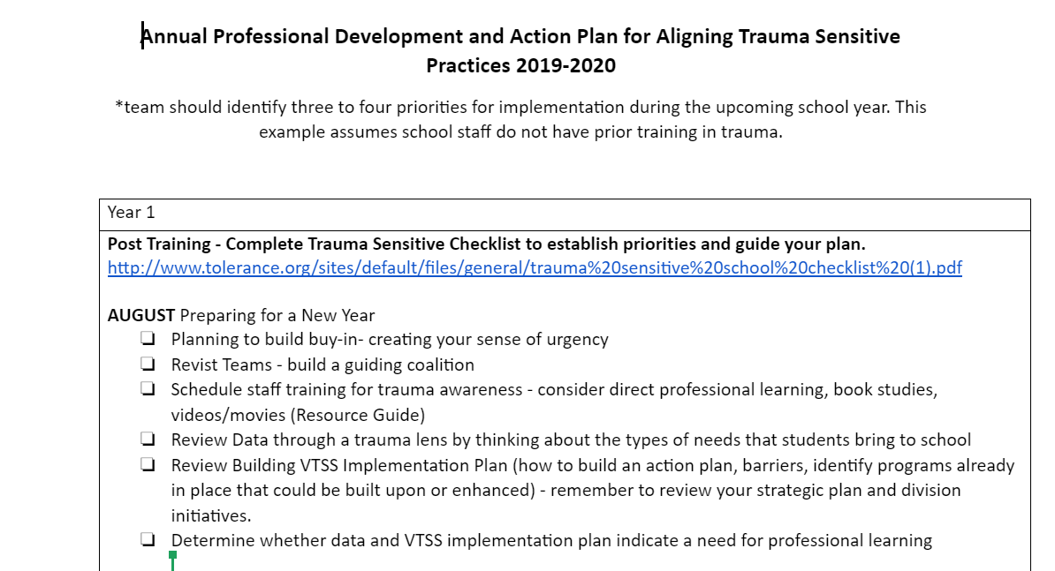
Professional Learning Example

Slide 12
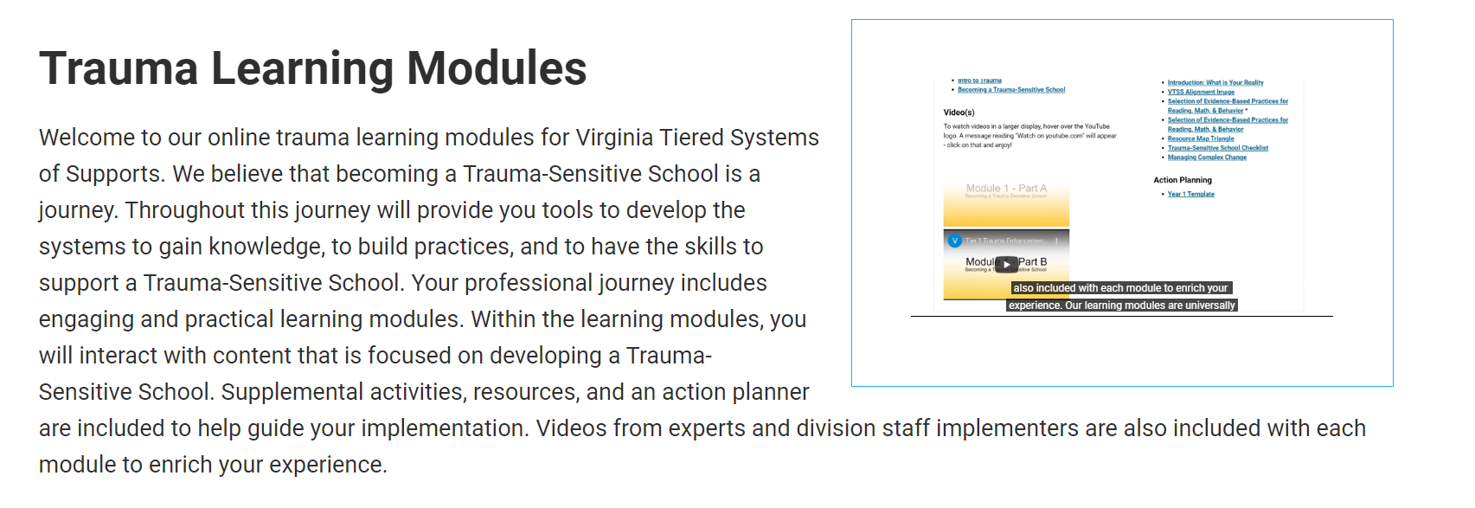
Trauma Modules: Team Breakouts
Each Module Contains:
Powerpoints with speaker notes
Infographics
Activities/References/Resources
Videos with noted trauma experts

Slide 13
Action Planning
Begin to develop your action plan around professional development.

Slide 14
Trauma Sensitive Schools within VTSS
Wrap-Up: Resiliency & Hope

Slide 15
Who has the greater ability of adapting to adversity?
Walter
More focused on extracurricular activities than academics
Works far below in some classes
Some consider father to be verbally abusive
Lives near 2nd highest crime area in the city.
Awkward in public/extremely shy
Very few close friends
No idea of what the future holds
Suspended for fighting in school
Chronically tardy for afternoon classes
Great Athlete
B Student
Son of a Ph.D.
Nurturing Neighbors
Articulate Speaker
Popular in High School
Recruited by Colleges
Almost always avoids trouble
Attends school regularly

Slide 16
Discussion
Why did you choose John or Walter?
How can our judgment or preconceived ideas play into our interactions with our students as we help them adapt and build competencies towards resilience?
John Walter

Slide 17
Resilience Defined
Resilience is the process of adapting well in the face of adversity, trauma, threat of significant sources of stress - such as family and relationship problems, serious health problems or workplace and financial stressors.
American Psychology Association

Slide 18
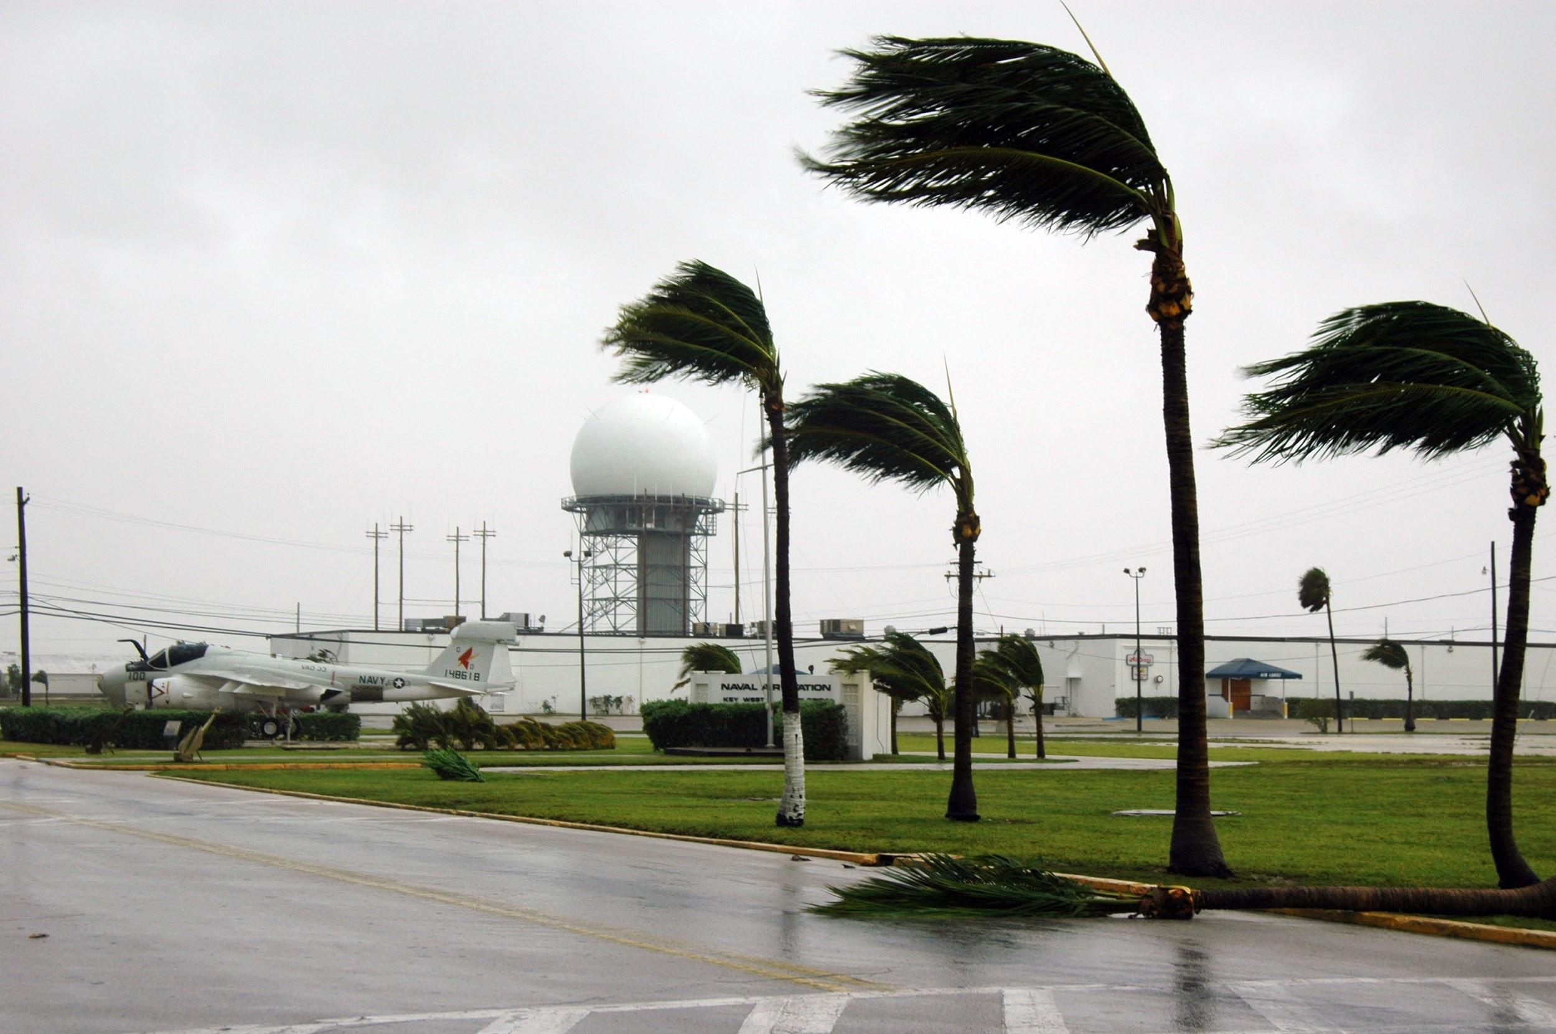
What it Looks Like

Slide 19
There is Hope
Resilience is not a trait that people either have or do not have. It involves behaviors, thoughts and actions that can be learned and developed in anyone.

Slide 20
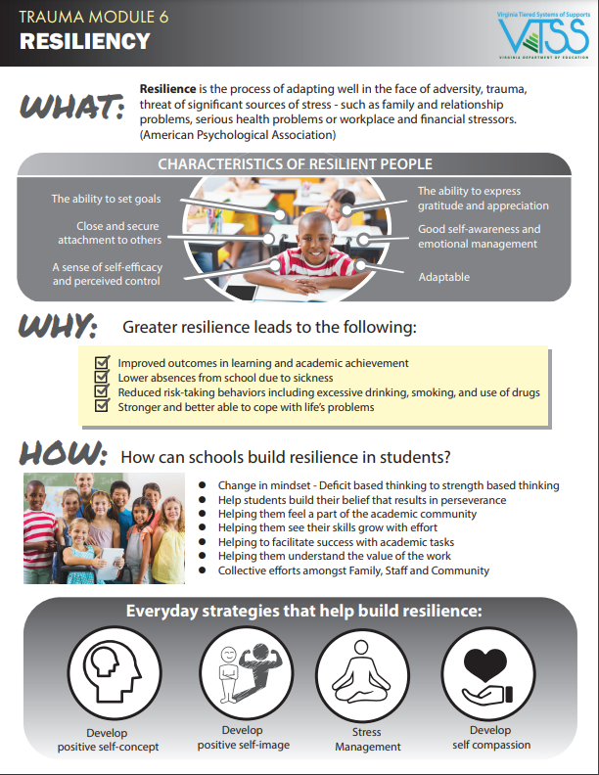
VTSS Trauma Learning Modules

Slide 21
Why? Because YOU Make the Difference!
External supports such as teachers were one of the three “triad of protective factors” linked to adaptation and positive outcomes for children who were exposed to adversity. (Howard,1996)

Slide 22
We may not see it...
“Research says that the biggest changes that we make in a kid’s life we will never know.”
~Jim Sporleder

Slide 23
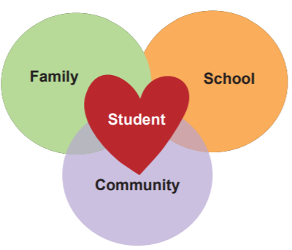
It Takes a Village

Slide 24
Why Hope Matters
“Hope is being able to see that there is light despite all the darkness.”
Bishop Desmond Tutu

Slide 25
Leave a Legacy of Hope
Find ways to encourage and affirm
Connection and empathy
Listen more than you talk
Be trauma sensitive in your responses
Apologize when you need to
Become an expert on your children
Focus on strengths not weaknesses
Help re-goal when there needs adjustment

Slide 26
Moving From Aces to Resilience
Please see your VTSS Systems Coach for a copy of this video

Slide 27
Your Personal Resiliency Card
Hope, Trust, Accepting Help, Laughter/humor, Positive Relationships, Letting Go, Developing a Sense of Control, Experience Success, Making Friends, Love, Self-Compassion, Kindness….
https://criresilient.org/product/resilience-trumps-aces-ace-cards-through-the-lens-of-aces/

Slide 28
Evaluation & Certificate

