Slide 1
Trauma Sensitive Schools within VTSS
Culture of Wellness

Slide 2
What We Will Know and Do
Understand the importance of a culture of wellness that supports self-care and collective care
Develop a system to support a culture of wellness
Create an action plan on how to introduce self-care to teams and colleagues

Slide 3
How are we doing?

Slide 4
Keep in mind…
We are intentional: “with purpose and intent”
Small changes can create positive ripples

Slide 5
You are stronger than you realize…
Loss of loved one
Caretaker
Diagnosis for you and/or others
Income change
Exhaustion
Basic needs are challenged
Family dynamics
Retirement, births, marriages, divorce
Travel or lack of travel
Virtual Learning
Political Climate
Therapy
Boundaries
Skill building
Budgeting
Discovering your talents
Trying something new
Dancing, singing, reading
Change in your eating habits
Choosing joy, laughter
Saying no, saying yes
Pet Therapy
Self-compassion
Forgiveness

Slide 6
The Why
Nearly one in four teachers said that they were likely to leave their jobs by the end of the 2020–2021 school year, compared with one in six teachers who were likely to leave, on average, prior to the pandemic.
A much higher proportion of teachers reported frequent job-related stress and symptoms of depression than the general adult population.
Job-Related Stress Threatens the Teacher Supply
Key Findings from the 2021 State of the U.S. Teacher Survey
by Elizabeth D. Steiner, Ashley Woo

Slide 7
The Why Continued
Teachers are a particularly stressed professional group and are affected more than average by psychological and psychosomatic complaints (Scheuch et al., 2015). In self-reports, teachers have almost unanimously identified classroom disruptions as the main stress factor in previous empirical studies (Scherzinger and Wettstein, 2019). Short-term psychosocial stressors, such as classroom disruptions, burden and impair the teacher-student relationship and negatively impact the students’ learning and achievement (Klusmann et al., 2016).

Slide 8
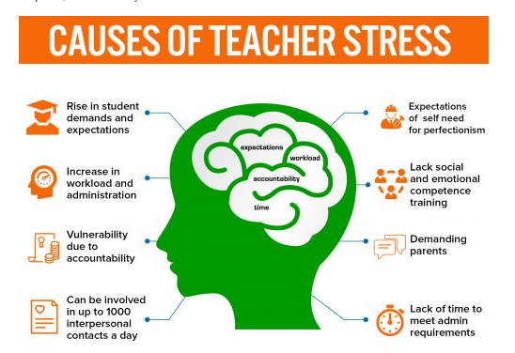
Triggers/Causes
Workbook

Slide 9
VTSS Trauma Learning Modules

Slide 10
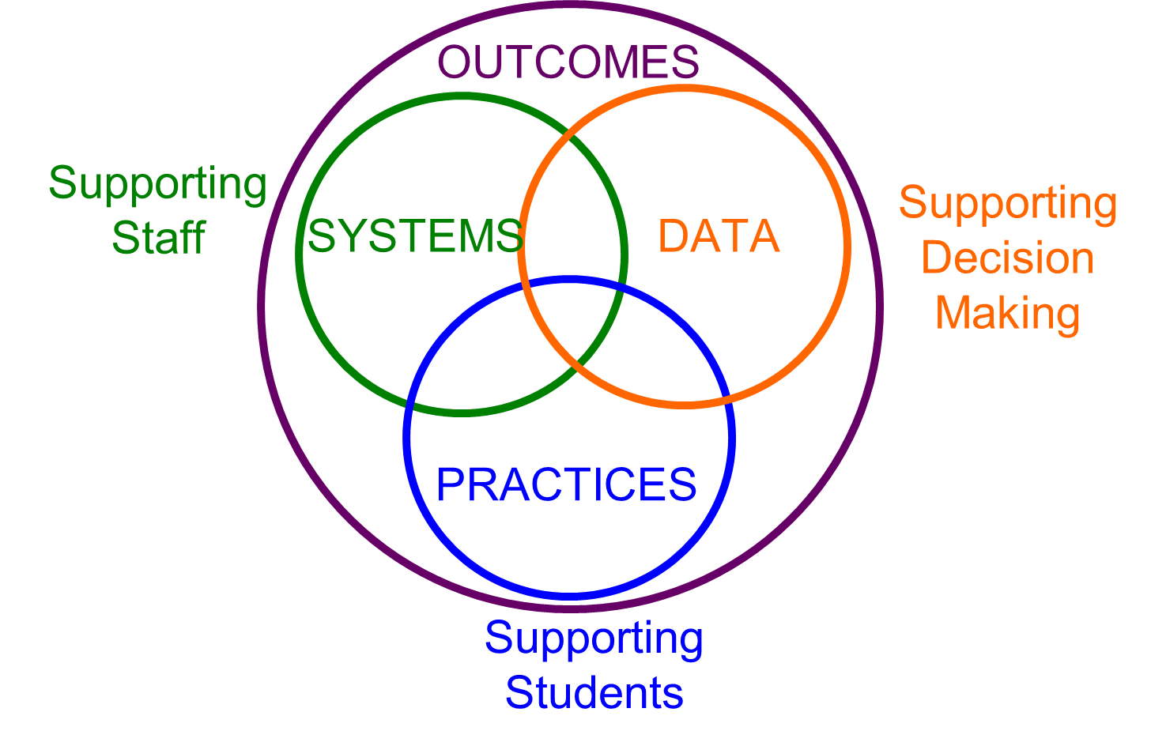
Implementation with Fidelity
Culture of Wellness: Emphasizes whole system response and prevention

Slide 11
Culture of Wellness Takes Time
Wellness requires ongoing and long-term schoolwide change and should not be treated as a superficial, siloed, or short-term goal. Designating one day, one person, or one initiative as the response to wellness will not improve teacher well-being and does not account for the diversity among teaching staff.
Positive school cultures take time to cultivate and a commitment of resources to sustain. This work requires individual and collective efforts as well as structural changes.
(https://annenberg.brown.edu/sites/default/files/EdResearch_for_Recovery_Brief_19.pdf)

Slide 12
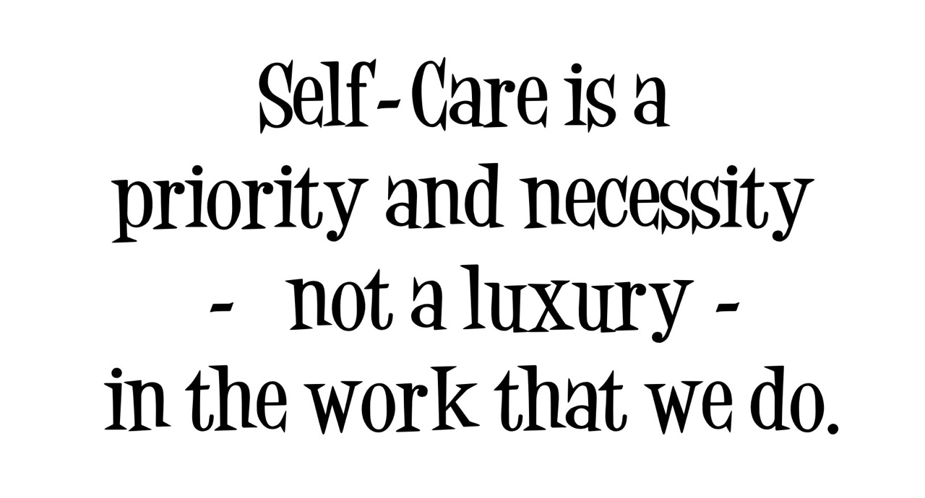
System: Supporting Staff
resource
Schools that prioritize staff wellness demonstrate positive interactions, a shared commitment for student success, and an increased sense of
warmth. (Bradshaw, et al. 2008)

Slide 13
Self-Care
What is self-care?
Self-care is any activity that we do deliberately in order to take care of our mental, emotional, and physical health. Although it’s a simple concept in theory, it’s something we very often overlook.

Slide 14
What is your first thought?
An administrator asks for phone calls to be put on hold unless an emergency, and takes a 30 minute break to have lunch alone in their office.
A veteran teacher works over contractual hours and comes in on weekends to work.
An employee takes a personal/annual day off to take care of themselves.
A group of teachers decide to have mental wellness breaks and take breaks in a quiet room with hot tea at approved designated times during the day.
An office manager leaves every day to have a
lunch break away from the office.

Slide 15
Brene Brown Empathy
Empathy fuels ____.
The 4 qualities of empathy:
Perspective taking: Recognizing that the person’s perspective is their _____.
Staying out of ________.
Recognizing _______ in others.
___________ that emotion--feeling with people.
Rarely does an empathetic statement start with “at _____”.
What makes something better is _________.

Slide 16
Professional Quality of Life (PROQoL)
Compassion Satisfaction
Compassion Fatigue
Burnout
Secondary Trauma/Vicarious Trauma
Workbook
Adapted from www.proql.org

Slide 17
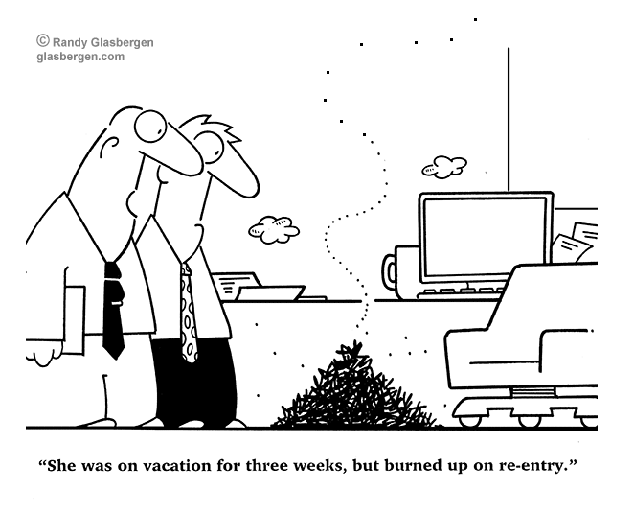
Burnout

Slide 18
Secondary Trauma
Secondary Trauma is the emotional distress that results when an individual hears about the traumatic experiences of another individual.

Slide 19
Vicarious Trauma
https://www.youtube.com/watch?v=uOzDGrcvmus&feature=youtu.be
Laura van Dernoot Lipsky https://www.youtube.com/watch?v=uOzDGrcvmus&feature=youtu.be

Slide 20
Strategies to Reduce Compassion Fatigue
Take Stock - What’s on your plate?
Find time for yourself everyday
Delegate - learn to ask for help
Have a strong social support both at work and home
Practice self-care
Have a transition from work to home
Learn to say no more often
Assess your trauma inputs
Attend regular professional development
How can leadership support staff?
Workbook

Slide 21
Warning Signs in Adults
Change in work personality
Change in their self-care (poor hygiene, they don’t participate in activities outside of school)
Working too many hours
Isolated from colleagues and withdrawn

Slide 22
What can administrators do?
1. APPRECIATION, LISTENING, AND EMOTIONAL SUPPORT
“Leadership made sure socio-emotional check-ins were just not for students but adults. Personal days were almost never denied & lateness at the top of the year wasn’t treated as a disciplinary action. There was just overall understanding that this was just not a normal time. There was vulnerability from top down about how hard everything is and to just frankly do our best.”

Slide 23
What matters most?
2. FLEXIBILITY WITH POLICIES AND CURRICULUM
3. PRIORITIZING PHYSICAL AND MENTAL HEALTH
“They CARED, and they showed it.”
4. LIGHTENING THE LOAD
“Central office has put a lot of emphasis on promoting student and staff wellness more than ‘catching up at all costs’.I feel like they’re working with, not against us.“

Slide 24
What matters most continued?
5. TRUSTING TEACHERS
“My administrator is the reason I have not left after 28 years. I have never felt more appreciated or trusted by my boss, even when I err as humans do.
“They trusted me and we made something amazing happen. It sounds crazy and it was indeed only for a year but it’s taking off again this upcoming school year! Stoked to see the program continue to build and grow!”

Slide 25
Wrap up for leaders
Keeping good teachers on staff doesn’t require advanced training or specialized knowledge. It’s a simple matter of staying humble, respecting your teachers, trusting in their professional training, and showing them that you care more about them as human beings than you do about how your school looks on paper.

Slide 26
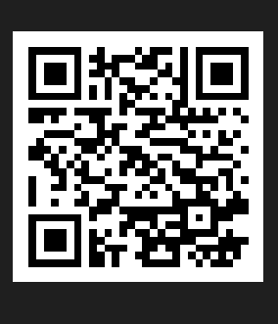
What is important to you?
Please use QR code or link in chat box.

Slide 27
Tips, Tools, Practices

Slide 28
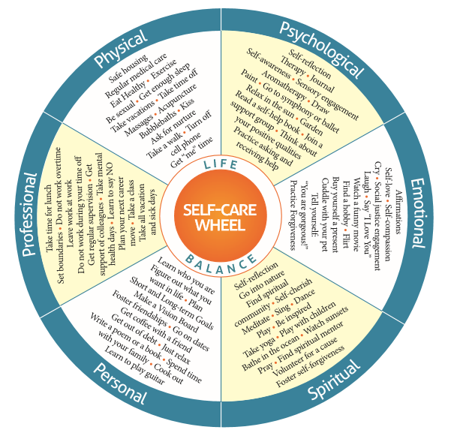
Self-Care Wheel
Workbook

Slide 29
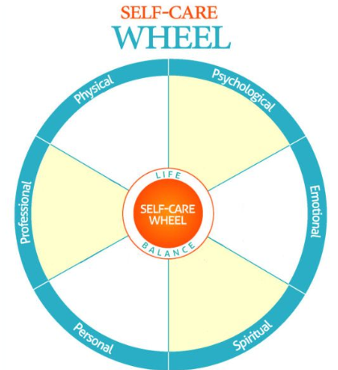
Self-Care Template
Workbook

Slide 30
Now and later: Using your Self-Care Wheel
https://www.thelazygeniuscollective.com/lazy/takecare (Resource)

Slide 31
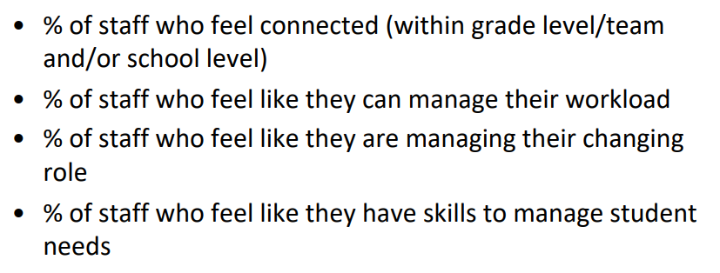
School Wide System Self Care
Develop a process for support at school
Understand Trauma (Professional Learning)
Review Data (absenteeism, school-climate data, surveys)
Encourage staff voice and support - What is your school currently doing to support staff members?
Workbook

Slide 32
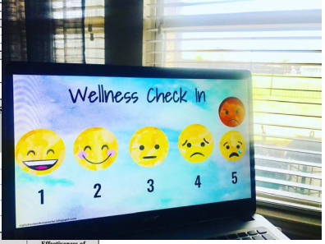
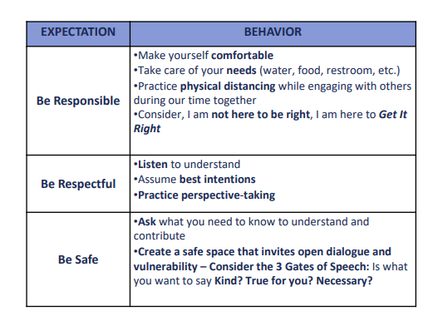
Other Ideas for a System of Wellness
Wellness check-ins for staff meetings and on the agenda
Departments take a designated day per month or week to engage in a wellness activity with staff, which can include celebrations and fellowship!
Staff Matrix to support wellness and voice
Tap in Tap out (see chat box)
Email free Fridays, weekends, holidays, after 5:00,etc
Create schedules that honor teacher planning and collaboration time during the day

Slide 33
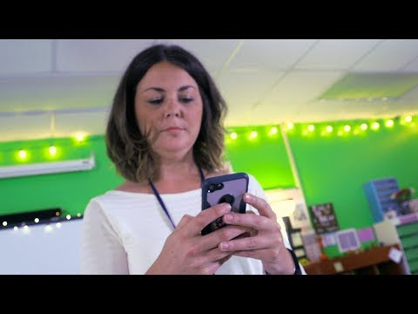
Tap in-Tap Out

Slide 34
Action Planning
Utilize your staff Matrix to incorporate practices, timeline, and resources
Create a resource area electronically and in target areas of the school/division
Schedule professional learning to raise awareness, generate surveys to collect data and ideas, and utilize the VTSS resources (Tier 1 Trauma Enhancement, Trauma Learning Modules)
Start small, stay consistent
Keep it novel, fun, and progress monitor

Slide 35
Collective Care

Slide 36
Let’s remember…
We are intentional: “with purpose and intent”
Small changes can create positive ripples

Slide 37
How to end the day: Gratitude for Others

Slide 38
Action Planning

