Slide 1
Trauma Sensitive Schools within VTSS
Introduction: Foundational Understanding of Trauma and Alignment of VTSS Framework
Notes:
This morning we are going to provide a quick introduction to Trauma Sensitive Schools within VTSS.

Slide 2
Our Norms for Success Include
Safety: Take Care of your needs. When you leave the room give us a thumbs up if you are okay, or a thumbs down if you need support. We want to support you.
Empowerment: Engage in activities and ask questions
Collaboration: Give everyone a chance to speak/a voice, work together
Trust: Assume good intentions, listen to others attentively, use supportive words in discussions
Choice: Share your expertise and ideas, consider others contributions

Slide 3
The “Why”
61% of Virginia adults experience at least one ACE before age 18.
In the average Virginia classroom, 12 out of 20 children have experienced at least one ACE.
Notes:
Also add some more acknowledgement of what is happening in the world and why we need this
https://static1.squarespace.com/static/5e790dd6d4b70c69a59c0236/t/5f0390585b6cfa0aa7a7de19/1594069082473/SEOW_ACEs+Report.pdf
We can never know without a doubt which of our students have experienced trauma and which haven’t. Some have experienced trauma but not told anyone, or had an experience they won’t label as trauma until years later. Some students are living in traumatic situations and can’t or won’t share this for their own safety.
Washington State determined that 13 out of every 30 students in a classroom will have toxic stress from 3 or more traumatic experiences. What we do know is that kids who experience toxic stress or chronic trauma have significant barriers to learning.
When we use trauma-sensitive strategies with all students, we ensure that the students who can’t ask for support are still getting it. Think of a wheelchair-accessible ramp to a building: Not every single person needs it, but it significantly removes barriers for those who do, and signifies to everyone that the building is an accessible place. We can do the same thing for our students impacted by trauma when we remove barriers and use trauma-sensitive strategies as a whole school.
https://acestoohigh.com/2012/05/31/massachusetts-washington-state-lead-u-s-trauma-sensitive-school-movement/

Slide 4
What we will know and do
Use the formal definition of trauma to define the impact that events and experiences may have on the students and adults in the educational setting
Understand the impact of trauma on learning, behavior, and worldview
How to align trauma sensitive practices into a multi-tiered systems of support and begin action planning for your division and schools.
Notes:
This learning opportunity for the next two sessions is focused on ways in which you can incorporate trauma sensitive practices into your Tier 1. We will start the morning with a basic understanding of trauma and how you can align trauma sensitive practices into your multi tiered systems of support.
Here are our learning intentions for this introduction.

Slide 5
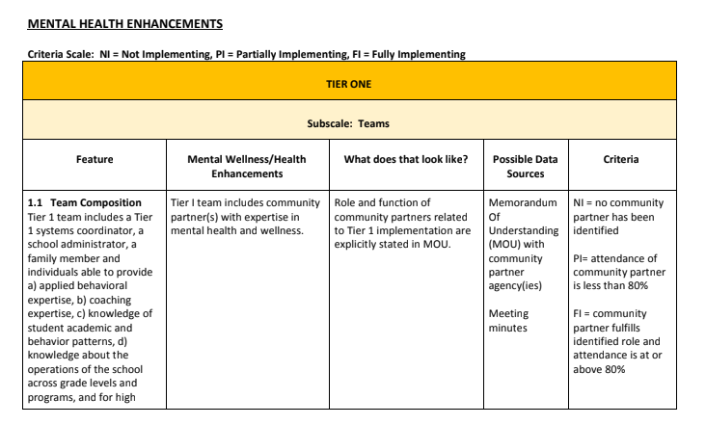
TFI Companion Guide: Mental Health Planning Tool
Notes:
WORKBOOK:
The VTSS Tiered Fidelity Mental Health Planning Tool will be our guide within our work along with reflections on your current PBIS Tiered Fidelity Inventory. How do they align and support the work of behavior and mental wellness? The companion guide is currently being piloted in some of our divisions with great success! So it is a good resource but not ready for distribution.
Link to guide: https://drive.google.com/drive/folders/19GKpQWz2CuUmV_izg8DnnfYPgBHhpC2l

Slide 6
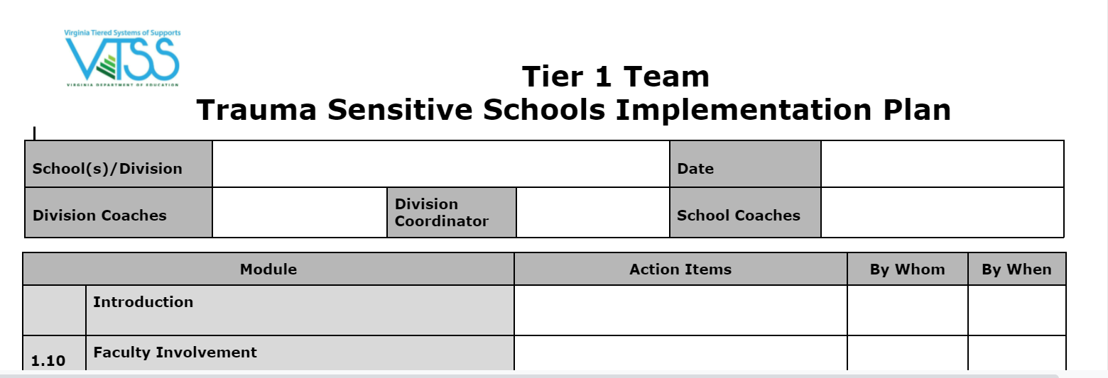
Implementation Plan
Notes:
Workbook:
This is the implementation planning tool that we will be using throughout the 3 days.

Slide 7
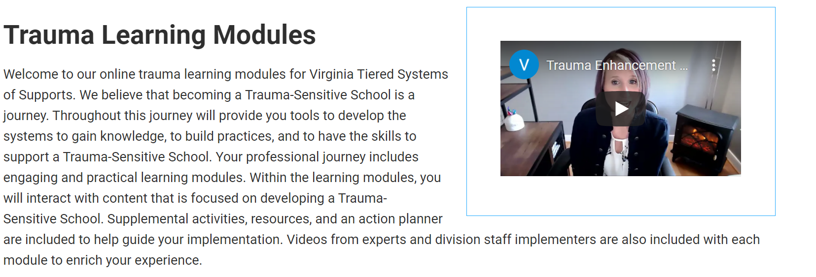
Trauma Modules
https://vtss-ric.vcu.edu/trauma-learning-modules/
Notes:
.Quick Mention, Day 3 will go into this more.
Put link in Chat box: https://vtss-ric.vcu.edu/trauma-learning-modules/

Slide 8
Self-Care Strategy: Take 5
A copy of this video can be obtained through your VTSS Systems Coach.

Slide 9
Formal Definition
Results from an event, series of events, or set of circumstances that is experienced by an individual as physically or emotionally harmful or life threatening and that has lasting adverse effects on the individual's functioning and mental, physical, social, emotional, or spiritual well-being.
Notes:
Let’s start with the basic definition of trauma, offered by the US Substance Abuse and Mental Health Services Admin (SAMHSA). When we consider this definition we look at the 3 E’s—Event, Experience, and Effects.

Slide 10
The Three E’s
The three E's of Trauma: Events, Experiences and Effects.

Slide 11
Example of the Three E’s
You can obtain a copy of this video through your VTSS Systems Coach.

Slide 12
The Impact of the Pandemic and Systemic Racism
Increase in mental health concerns such as anxiety, depression, and eating disorders
Increase in substance use
Equity in access to resources: medical, technology, basic needs such as food and housing
Somatic complaints (headaches, trouble sleeping, illness)
Feelings of isolation, hopelessness, and fearful of the future
Job loss, financial stressors, interpersonal conflicts, low self-worth
Notes:
Annotate:
In our current reality we need to be aware of the impact of the pandemic and systemic racism on our students. Take a moment to view these bullets. Which ones resonates with you and for your division? (pause for 30 seconds)
For more information and statistics: https://www.kff.org/coronavirus-covid-19/issue-brief/the-implications-of-covid-19-for-mental-health-and-substance-use/
Resource: https://www.health.harvard.edu/blog/how-racism-harms-children-2019091417788
https://www.kff.org/health-reform/report/kff-health-tracking-poll-early-april-2020/
REsource: https://ccpfc.org/about-pfc/racial-inequities/

Slide 13
Vignette: Event
The type and severity of the event
Frequency of the event (whether it was one time or chronic)
Duration (how long it lasted both if chronic or one time)
The identity of the user.
Jackson, A. (2017). Impact of Childhood Trauma on Health: Adverse Childhood Experiences and Resilience. Family Impact Seminar: Richmond, VA.

Slide 14
Vignette: Experience
Whether the child decided to fight, flight or freeze
The timing (age of the child)
The presence of a positive relationship with one adult
The intervention
Jackson, A. (2017). Impact of Childhood Trauma on Health: Adverse Childhood Experiences and Resilience. Family Impact Seminar: Richmond, VA.

Slide 15
Vignette: Effect
As we have addressed throughout this training, thus far, the third “e” of trauma, effects is significantly impacted by the previous two “e’s,” event and experience.
Jackson, A. (2017). Impact of Childhood Trauma on Health: Adverse Childhood Experiences and Resilience. Family Impact Seminar: Richmond, VA.

Slide 16
Turn and Talk
Using a situation from your school/division, how could you apply the 3 Es to better understand the student and their situation?

Slide 17
The Meaning of the Event
Personalization of the experience-feeling targeted
Feeling responsible for the event
Taking ownership of the feelings-Believing you are bad
Using it as evidence that bad things will happen because you are bad
Lisa Ferentz

Slide 18
Categories of Trauma
Systemic - Features of environments and institutions that foster, maintain and impact responses.
Acute - A single incident
Developmental -Multiple or chronic exposure to either acute or systemic trauma.

Slide 19
Adverse Childhood Experiences
You can obtain a copy of this video through your VTSS Systems Coach.

Slide 20
Impact of Trauma on the Child
Brain
Relationships
Learning
Behavior
Worldview

Slide 21
Impact on School Functioning
Difficulties with attention and learning
Lower test scores
More absences
Higher suspension rates
Internalizing behaviors (depression, anxiety)
Difficulty regulating emotions
2.5 times more likely to be retained
More discipline referrals
Externalizing behaviors (Defiance, hyper activity)
More frequently placed in special education
More likely to have struggles in receptive & expressive language
National Child Traumatic Stress Network 2008
Notes:
Children who have experienced Adverse Childhood experiences also experience the following:
Pause and read this extensive list.
Activity: Annotate - What are some of the items that you see in your context, and Chat box - things are missing?
This is why becoming a TSS is so important.

Slide 22
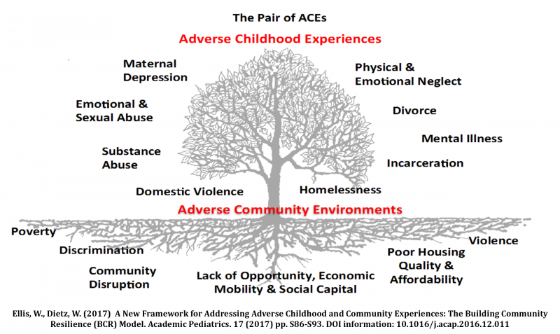
Community and ACE
Notes:
As we heard in the video - Adverse childhood experiences are an American public health problem. They affect everyone – all races, genders, and education and income levels – in every community across the country. The ACEs tree image grew out of the need to illustrate the relationship between adversity within a family and adversity within a community. The leaves on the tree represent the ‘symptoms’ of ACEs that are easily recognized in clinical, educational and social service settings, such as a well child visit or a pre-school classroom. The tree is planted in poor soil that is steeped in systemic inequities, robbing it of nutrients necessary to support a thriving community. Adverse community environments such as a lack of affordable and safe housing, community violence, systemic discrimination, and limited access to social and economic mobility compound one another, creating a negative cycle of ever worsening soil that results in withering leaves on the tree.
Every system or organization that touches an aspect of a child’s life and family can contribute to community resilience. Rich Soil Results in a Resilient Community. If the soil is improved through investments in economic development, affordable housing or educational opportunities, for example, the branches on the tree will grow stronger, yielding healthier leaves. This will translate into improved and measurable outcomes, such as increased kindergarten readiness, increased high school graduation rates, lower crime rates and increased economic mobility for children and families.

Slide 23
Impact of Trauma on the Child-2
Brain
Relationships
Learning
Behavior
Worldview
Notes:
How does this impact school-aged youth?
Trauma can have a direct, immediate, and potentially overwhelming impact on the brain, forming relationships, the ability to learn, inappropriate behavior, and how a child views the world. Learning about the impacts of trauma can help educators from misunderstanding the reasons underlying some children's difficulties with learning, behavior and relationships.
Throughout this training we will highlight each of these areas. In this introduction we will highlight the brain and worldview.

Slide 24
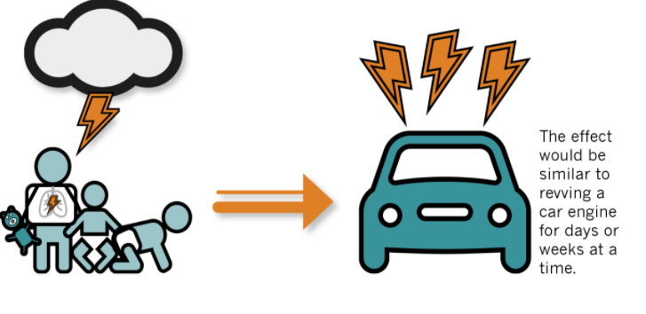
Stress Response System
Picture source: https://developingchild.harvard.edu/resources/aces-and-toxic-stress-frequently-asked-questions/
Notes:
chat box: https://youtu.be/KoqaUANGvpA
One key concept in our trauma-sensitive work is understanding of the stress-response system. Our bodies and brains react to danger in order to keep us safe. Trauma can make this system less effective, causing our stress-response system to activate whether or not real danger is present. This information can get very technical when we explore the neurological systems behind the stress response system. Dr. Jacob Hamm illustrates in his youtube video (share link - https://youtu.be/KoqaUANGvpA) the differences between a calm state for learning and a brain attuned to survival. He talks about the learning brain as the balcony view and able to look over the forest as to what is going on. He describes the survival brain as someone who thinks only in black and white and are filled with doubt and panic. He states that survival brain always trumps learning brain. When we are in our emotional brain, learning will not occur. We can’t always predict individually or for those we are working with what triggers our brains to move from the thinking brain to the emotional brain—our survival brain.
Experiencing many ACEs along with things like racism or community violence can literally “get under our skin” and cause toxic ongoing stress. this excessive activation of the stress response system can lead to wear and tear on the body and brain. To give you a visual it would be the same as reviving a car engine for days or weeks at a time.

Slide 25
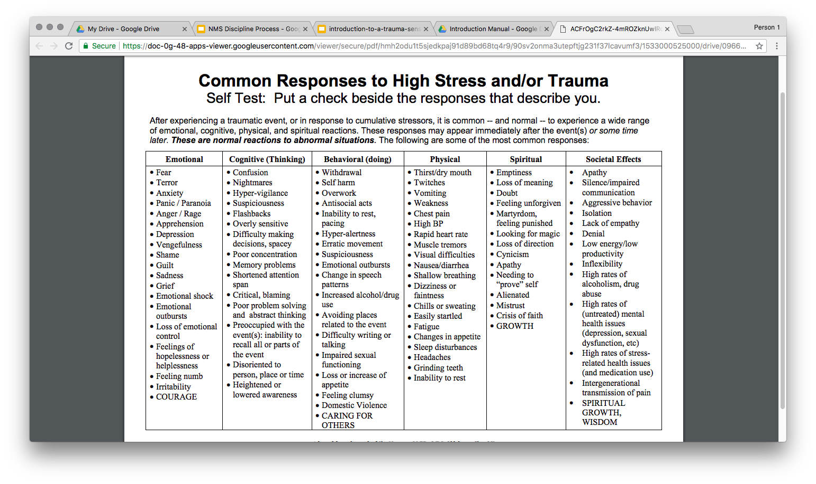
Common Responses to High Stress of Trauma
Notes:
On page 8 of your workbook you will discover common responses to high stress and/or Trauma. Use this as a tool to understand and offer prevention strategies, support, and empathy.
Give them this resource to look at and review.
Create a poll: How does stress show up for you?
Emotional
Cognitive(Thinking)
Behavioral (Doing)
Physical
Spiritual
Societal Effects

Slide 26
How Does Trauma Impact Worldview?
Typical Development
Developmental Trauma
Belief in a predictable and benevolent world
Positive self-worth
Hopeful and optimistic about future
Empowered
Basic mistrust of others
Belief that the world is unsafe
Negative self-worth
Fear and pessimism about the future
Hopeless and powerless
Notes:
One of trauma’s most harmful effects is its ability to shatter our worldview. Some describe their world after trauma as crumbling. Some of our students see the world through eyes that have witnessed the worst things possible. This creates a landscape of mistrust and fear. It becomes very hard to be able to trust the world again and it is harder to find meaning amid the rubble of the crumble. Our students, as they grow, develop a worldview. This becomes their assumptions about life and where they fit in.

Slide 27
Trauma Changes Perceptions
I am not safe
I cannot trust others
I cannot trust myself
I cannot depend upon others
I am not worthy of care
I deserve the bad things that happen to me
It’s my fault
Notes:
We all hold implicit and invisible pre-judgements about the world and our place in it, such as: I am a good person; if I am a good person, good things will happen, the world is a safe place; other people are good and trustworthy.
A traumatic event erases our invisible assumptions. What we once thought to be true is false. Where we once found safety and security, we now sense uncertainty and danger. Trauma reverses our belief in ourselves. Trauma rewrites our perceptions about the world and how we view it - it shouts that the world is not safe, I have no control, I can’t trust.
In your workbook on pages there is an activity you can do with your team on seeing the school environment through the worldview of a student who has experienced trauma.

Slide 28
What is SEL?
Social Emotional Learning is the process through which children and adults acquire and effectively apply the knowledge, attitudes, and skills necessary to understand and manage emotions, set and achieve positive goals, feel and show empathy for others, establish and maintain positive relationships and make responsible decisions.
Notes:
To Know: CASEL (Collaborative for Academic, Social and Emotional Learning) defines SEL above.
To Say: “Social and emotional learning (SEL) is an integral part of education and human development. SEL advances educational equity and excellence through authentic school-family-community partnerships to establish learning environments and experiences that feature trusting and collaborative relationships, rigorous and meaningful curriculum and instruction, and ongoing evaluation. SEL can help address various forms of inequity and empower young people and adults to co-create thriving schools and contribute to safe, healthy, and just communities.”
Reference: This comes directly from https://casel.org/what-is-sel/

Slide 29
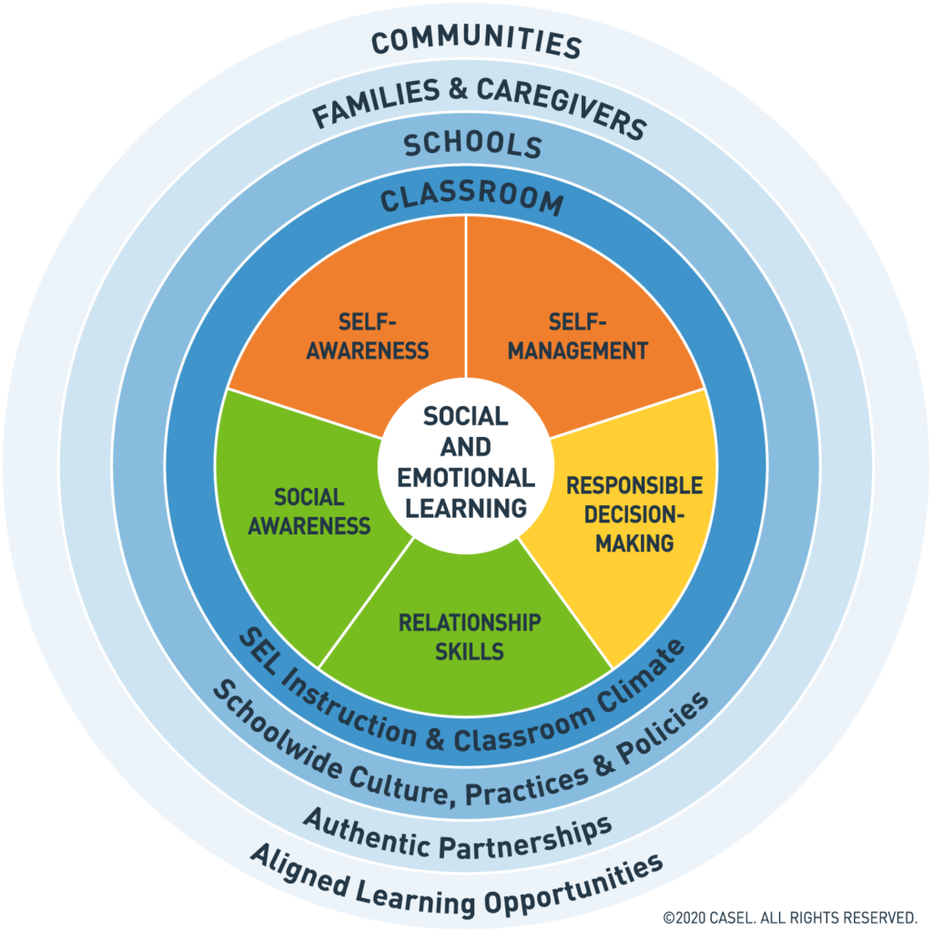
Where? SEL in School, Classroom, Families, and Communities
Notes:
To Know: This figure depicts the CASEL framework.
To Say: Systemic SEL is promoted across multiple contexts, every day. This framework and slide emphasize the importance of establishing equitable learning environments and coordinating practices across key settings. The classrooms, schools, families, and communities work together to enhance all students social emotional and academic learning. This includes policies, how we are incorporating SEL into daily instruction, how we are connecting with our families and communities.

Slide 30
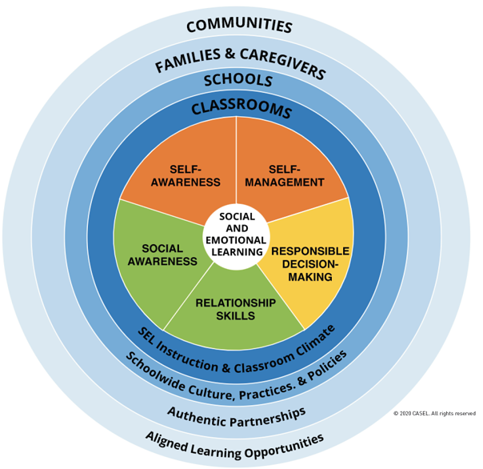
Indicators of School-Wide SEL
How?
Why?
What and Where?
Implementation Focus Areas
Build Foundational Support and Plan
Strengthen Adult SEL Competencies and Capacity
Promote SEL for Students
Practice Continuous Improvement
Student Outcomes
Improved attitudes about self and others
Academic Success
College and Career Readiness
Healthy Relationships
Notes:
To Know/To Say: Whenever we are looking at systems we do the how, what (SEL competencies), where (schools, communities and families), why (buy-in), and the how (implementation)
Reference: https://casel.org/wp-content/uploads/2020/08/CASEL-Equity-Insights-Report.pdf

Slide 31
Integrating Trauma Sensitive Schools
INTEGRATION WITHIN VTSS
Notes:
As we know from PBIS, anything you do is more effective if you are doing it school-wide. The strategies that we are suggesting need to be integrated into your Tier 1.

Slide 32
Language Matters
Trauma Sensitive
Trauma Informed
A framework in which schools acknowledge the high prevalence of traumatic exposure for students, the importance of staff well-being and strives to meet the unique needs of all learners.
Black, P., Cook, E. & Daniel, S. 2017
A framework which arose in the behavioral health field which recognizes all types of trauma and an awareness of the impact it can have across settings, services, and population.
Notes:
The model of a trauma-sensitive school is most effectively created and maintained when universal supports and strategies are part of daily school programming. If these supports are in place, fewer students will need more intensive intervention in order to be successful in school. While behavioral health services will be an important part of the effort, the term “trauma-sensitive” conveys that helping children who have experienced trauma learn at school requires a school-wide culture that fosters feelings of safety and support. Emphasizes that educators are not expected to take on the role of therapists. Describes a school in which all students feel safe, welcomed, and supported and where addressing trauma’s impact on learning on a school-wide basis is at the center of its educational mission.

Slide 33
Small Group Work
Why do we need trauma sensitive practices?
Why is this important to you, your school, your community?
Notes:
Breakout 5 minutes:
What is your why?
Why trauma sensitive practices?
Why is this important to you, your school, your division, your community?

Slide 34
Care Values
SAFETY
EMPOWERMENT
COLLABORATION
TRUST
CHOICE
Notes:
WORKBOOK:
Resource: https://dpi.wi.gov/sspw/mental-health/trauma/modules
CARE Values builds on resiliency and we talk more about this in other modules.
SAFETY: This includes creating spaces where people feel culturally, emotionally, and physically safe as well as an awareness of individual’s discomfort or unease.
Going back to Maslow’s work, we are not going to get anywhere with a child’s education when they don’t feel safe.
Despite what we may like to believe, we have to remember that we do not get trust by default, we have to earn it.
This is especially relevant in education when working with children who have experienced terrible things at the hands of the adults that were supposed to protect them from harm.
EMPOWERMENT-This includes the recognition of an individual’s strengths. These strengths are built on and validated.
To what extent do our activities and setting provide opportunity for skill building and the opportunity to practice those skills?
How often do we give children and school staff a chance to practice those things we tell them they should be doing and hopefully have been teaching/coaching them through?
COLLABORATION: This includes the recognition that collaboration happens in relationships and partnerships with shared decision-making.
We spend way too much time as adults coming to solutions that are ill informed because they do not involve the major players in the approach…the child, the family and the community as a whole in addition to school professionals.
Use student voice: student led, vocabulary/comprehension/native language
We should not wait until we see challenging behavior.
One, because that isn’t proactive, and
Two because some of the kids that need our help fall under the radar because they don’t display challenging behavior (which we will continue to learn about throughout our modules.
TRUST-This includes the recognition of the need for an approach that honors the individual’s dignity.
Despite what we may like to believe, we have to remember that we do not get trust by default, we have to earn it.
This is especially relevant in education when working with children who have experienced terrible things at the hands of the adults that were supposed to protect them from harm.
In order to gain trust, the people and the environment must be predictable.
As adults, we do as we say we are going to do.
If we say we will keep the child (in many cases this is true also of our colleagues working with these students) safe and treat them with dignity and respect, we do that.
Our interventions for when things are not going as well have to reflect this as well.
This also speaks to the importance of the approach being school wide, not just with certain adults or classrooms.
CHOICE-This includes the meaningful sharing of power and decision-making. Transparent operations and decisions maintain trust. Ensure trustworthiness through clarity and consistency in all actions.
In a trauma sensitive school, we want to embed choice whenever we can.
Choice and collaboration tie in together as both emphasize the significance of student involvement and voice.
Often, the more intense and challenging that the behavior gets, the more decisions adults tend to make for the child.
this tends to intensify the challenging behavior because this is something that has been stripped from the lives of children who have experienced developmental trauma.

Slide 35
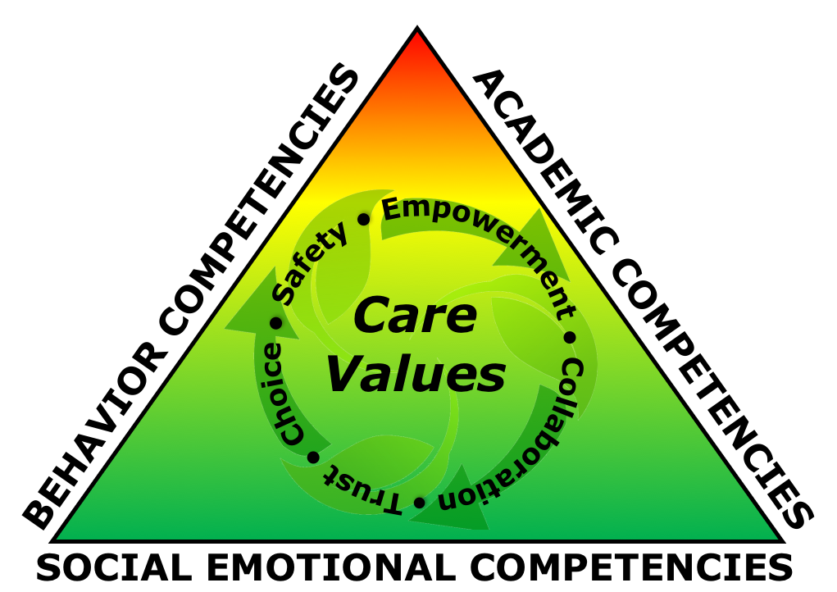
A Blended Model

Slide 36
A Blended Model- Example
Academic Competencies | Behavior Competencies | Social Emotional Competencies
Activities are structured in predictable and emotionally safe ways and information is presented, learning assessed, using multiple modes. | Expected academic and social behaviors are taught directly to all students in classrooms and across other campus settings/locations | Team uses community data and student and family perception data/focus groups to inform development of student expectations as well as staff expectations for the teaching matrix

Slide 37
Stages of Building a Trauma Sensitive School
Exploration
Installation
Implementation
Sustainability
Purpose and vision
Build knowledge
What do we need to know about instruction?
What do we want to know about climate and culture?
Who are impacted stakeholders?
We are starting HERE today!
Establish the infrastructure
Develop plan
Who will lead the efforts? Teams?
Training
Begin implementation
Data analysis - Learn and improve
Align and integrate with other practices (PBIS, SEL, RP, Academics)
Include families and communities
Evaluate impact
Has climate improved?
Is instruction improving?
Adjustments
Notes:
We have phases we go through for implementation (SEL, trauma, academic). Everything we do follows the same way of work.

Slide 38
Vision and Mission
Positive and proactive approach
Collective perspectives that represent the community
A culture that is trauma sensitive

Slide 39
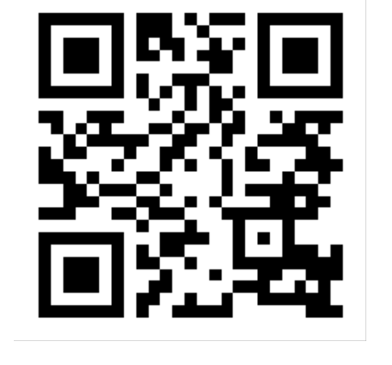
Our Vision and Mission
What words can you incorporate into your Tier 1 Team’s vision and mission that include an explicit focus on the social-emotional
development and well-being of students?
https://app.sli.do/event/t2mm1yzh
Notes:
Chat box: https://app.sli.do/event/t2mm1yzh

Slide 40
Trauma Sensitive Foundations
See systems coach for chart
Notes:
Think about what some of the big pieces are...

Slide 41
Integrated SEL and Trauma
Focused on creating safe and inclusive opportunities for all
Builds individual and collective agency and resilience
Supports systems change to transform structures of injustice amd to promote robust equity
Supports and benefits from positive school climate, conditions for learning, and restorative practices
Notes:
To Know/To Say: It is important to emphasize the importance of school climate and integration of SEL and trauma sensitivity into daily practice, along with an expanding focus on creating safe and inclusive opportunities for all, both approaches are guided by common principles, such as safety, supportive relationships, youth and family empowerment, cultural competence, and focus on well-being.
With a clear understanding of complementarity, educators, in partnership with students and families, can work to articulate a shared vision for their schools and classrooms that includes a commitment to integrating both approaches to further their goal of creating safe, inclusive, and engaging learning environments.
We want to develop a shared understanding and integrated vision for this work.
Reference: https://www.prevention.psu.edu/uploads/files/TSS-SEL-Brief-Final-June2021R.pdf

Slide 42
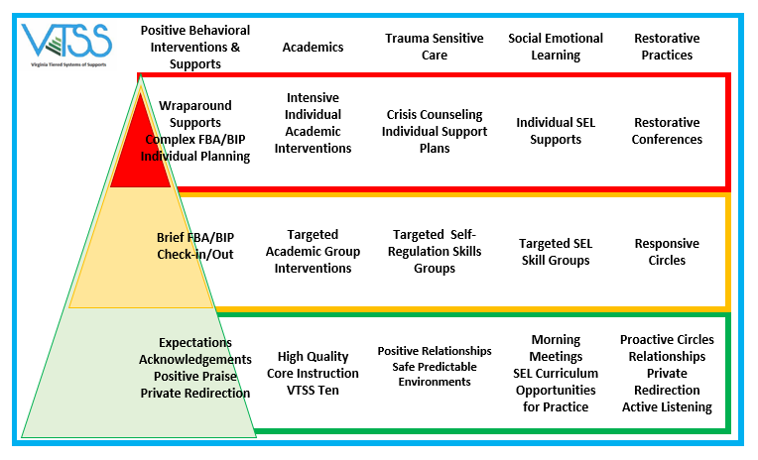
Connecting the Dots
Notes:
This is a great slide to show you what I mean. You’ll notice behavioral, academic, and social-emotional wellbeing supports are all a part of their tiered system that supports an effective learning environment. If you look closely you can start to see similarities within the tiers. Trauma sensitive practices share core objectives that are wholly allied with SEL models. In order to integrate and align we need to focus on the commonalities and how each support one another.
For example: We know that self-regulation is hard for some students exposed to trauma. Self regulation is a social emotional skill that can be taught. PBIS teaches routines and procedures which directly impact self-regulation.
Adapted and Inspired from Chesterfield County Public Schools

Slide 43
VTSS Implementation Logic
Implement behavior, academic and social emotional supports through a single team.
Data – What we use to make decisions: Progress Monitoring, Fidelity
Practices – What we do to support students.
Systems – What we do to support adults to implement the practices.

Slide 44
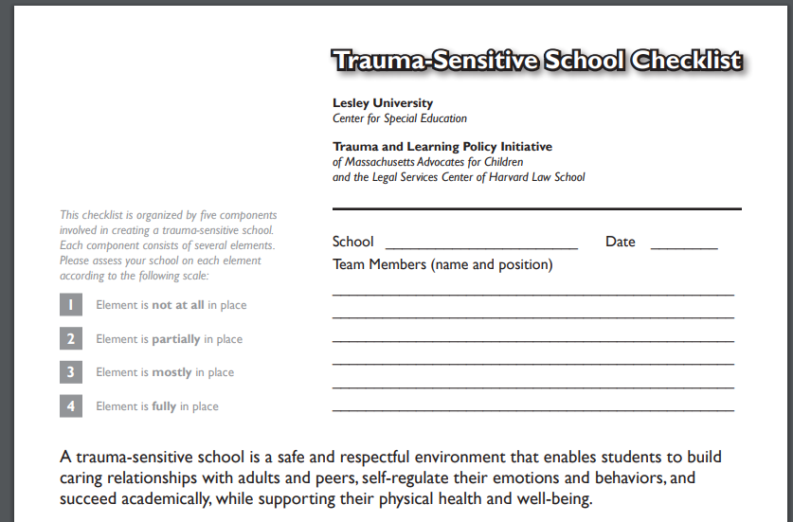
Trauma-Sensitive Checklist
Notes:
Workbook:
there are many to pick from, and it's always good to explore what is currently out there and select what fits your context.

Slide 45
Continuum of systems
Parallel | Alignment | Integration
Academics, behavior, and social emotional are separate systems | Academics, behavior, and social emotional are separate, but supportive systems | Academics, behavior, and social emotional are one interwoven system
Competition for staff and resources | Barriers for implementation resources are minimized across practices | Seamless connection, Resources build upon each other
Notes:
Script: MTSS Integration falls on a continuum of connectedness that includes parallel, alignment, and integration. Consider where you believe your school falls on this continuum.

Slide 46
Success
Use the formal definition of trauma to define the impact that events and experiences may have on the students and adults in the educational setting
Understand the impact of trauma
How to align trauma sensitive practices into a multi-tiered systems of support
Notes:
Have participants use annotate: X if they did not get it, Check if they did and - if they are still working on it.

