Slide 1
Module Introduction
Welcome to our on-line trauma learning modules for Virginia Tiered Systems of Supports. We believe that becoming a Trauma-Sensitive School is a journey. Throughout this journey will provide you tools to develop the systems to gain knowledge, to build practices, and to have the skills to support a Trauma-Sensitive School. Your professional journey includes engaging and practical learning modules. Within the learning modules you will interact with content that is focused on developing a Trauma Sensitive School. Supplemental activities, resources, and an action planner are included to help guide your implementation. Videos from experts and division staff implementers are also included with each module to enrich your experience.
Finally, our six modules are focused on the following topics: Module 1: Introduction to Trauma and Becoming a Trauma-Sensitive School; Module 2: Families and Communities as Partners; Module 3: How Trauma Impacts Learning; Module 4: Strategies and Classroom Practices (academic, social emotional learning, trauma-sensitive environments, regulation, cognitive problem solving, relationships, school wide discipline, self care); Module 5: Implementation and Systems (division, staff, administrators); Module 6: Resilience.

Slide 2
Hidden Slide #1
This Module was designed to be used in the following manner.
The audience for this Module is division and school teams, families, communities.
This Module is meant for whole staff presentations.
Following this training, participants should complete the Action Plan document to determine next steps.
There are two sections in this module. Teams are not required to complete all components of the Modules. Instead, participants will complete only those Modules that fit the needs of their school.
Notes:
This Module is designed to be completed in 2 hours and each powerpoint section in 1 hour.

Slide 3
Hidden Slide #2
In person training
Presenter notes and information
Notes:
In-person training suggestions
The Trauma Introduction Module in-person training should take about 2 hours in its entirety. Each section takes at maximum 1 hour.
This presentation provides the basics of trauma and trauma sensitive schools. You may want to add or enhance portions with visuals and examples that will resonate with your audience. As a reminder, always be sure to include appropriate citations when adding resources. Also, you might look to the resources and activities sections for additions that may be helpful.
In summary
This module outlines the basics of trauma and trauma sensitive schools
It can be adapted to individual contexts
The training should last about 2 hours for the entire module or 1 hour for each section
Presenter notes information
Presenter notes are included in the PowerPoint. Background information for the presenter is shown as “To Know.” Statements to be shared with participants are shown as “To Say.” In some instances, the “To Know/To Say” are combined.The presenter notes also include “To Do” prompts and cues for “Handouts”.
Additional activities, examples, videos, etc. are being developed. A presenter may add material from the resources and activities section on the website.
Breaks should be inserted at the discretion of the presenter based on the needs of participants.

Slide 4
Hidden Slide #3
Supplies needed
WIFI access for presenter and participants
Access to videos (through WIFI if available, but download to flash drive as a back-up)
Chart paper
Markers
Post-it-Notes
Notes:
To Know
These supplies are needed for the Trauma Professional Learning Modules.

Slide 5
Hidden Slide #4
Handouts:
What is your reality?
Action Planner
Notes:
To Know
The Participant and Presenter Materials are located on the vtss-ric website.
References

Slide 6
Hidden Slide #5
Key Terms in This Module:
Trauma
Systemic Trauma
Acute Trauma
Developmental Trauma
Adverse Childhood Experiences
Learning Brain
Survival Brain
Notes:
To Know
These are the key terms used throughout the module.

Slide 7
Introduction to Trauma
Module 1
Notes:
To Know:
VTSS Professional Learning Modules are organized in the same manner. All schools can begin their journey with Module 1 which introduces the foundational knowledge around trauma and trauma sensitive schools. This powerpoint shares key information on how we create trauma-sensitive, safe and supportive schools.
To Say: Welcome to the learning module, “Introduction to Trauma”. We are appreciative that you are here today and willing to engage in this work that is important to so many staff and students. We are looking forward to engaging you in various conversations and activities to grow your skillset related to trauma sensitive practices and hope you find this information both meaningful and applicable to your work. Let’s get started!

Slide 8
Learning Intentions
Review the formal definition as well as the three categories of trauma
Determine who trauma affects
Understand the impact trauma has on a child’s educational experience
Notes:
To Know:
Go over the learning intentions targeted for this session
To Say:
During this module we hope you will begin to develop a basic understanding of the impact of trauma. We will start with the definition and categories of trauma and then guide you through the exploration of the impact that trauma can have on a child’s educational experience.

Slide 9
Definition of Trauma
Results from an event, series of events, or set of circumstances that is experienced by an individual as physically or emotionally harmful or life threatening and that has lasting adverse effects on the individual's functioning and mental, physical, social, emotional, or spiritual well-being.
Notes:
To Know:
Introduce the definition of trauma. This is also introduced in our video that goes along with this module.
To Say:
Let’s start with the basic definition of trauma, offered by the US Substance Abuse and Mental Health Services Admin (SAMHSA). This is SAMHSA’s comprehensive definition of trauma, however we will be breaking it down using the three E's of Trauma: Events, Experiences and Effects to have a foundational understanding of trauma. Trauma results from an event, series of events, or set of circumstances that is experienced by an individual as physically or emotionally harmful or life threatening and that has lasting adverse effects on the individual’s functioning and mental, physical, social, emotional, or spiritual well-being. It will be important to consider event, experience and effect as we explore the impact trauma can have on an individual.
Reference:
https://www.samhsa.gov/trauma-violence

Slide 10
Definition of Childhood Trauma
"Childhood trauma" means any emotionally disturbing or distressing event or experience occurring during childhood that could have a lasting negative effect on a child's physical, emotional, and behavioral development and health, including adverse childhood experiences, or childhood physical or emotional abuse or neglect, sexual abuse, alcohol or substance abuse in the home, mental illness in the home, incarceration of a family member, witnessing domestic violence, and parental divorce or separation.
Virginia Senate Bill 1300 https://legiscan.com/VA/text/SB1300/id/2766879
Notes:
To Know: Introduce the definition of childhood trauma.
To Say: Let’s talk about how Trauma is defined in childhood. Childhood trauma means any emotionally disturbing or distressing event or experience occurring during childhood that could have a lasting negative effect on a child's physical, emotional, and behavioral development and health, including adverse childhood experiences, or childhood physical or emotional abuse or neglect, sexual abuse, alcohol or substance abuse in the home, mental illness in the home, incarceration of a family member, witnessing domestic violence, and parental divorce or separation.
Reference: Virginia Senate Bill 1300 https://legiscan.com/VA/text/SB1300/id/2766879

Slide 11
Categories of Trauma
SYSTEMIC
Features of environments and institutions that foster, maintain and impact responses.
DEVELOPMENTAL
Multiple or chronic exposure to either acute or systemic trauma.
ACUTE
A single incident
Notes:
To Know:
There are three categories of trauma: Systemic, Acute, and Developmental.
To Say:
Before we examine impact we must first explore the three types of trauma. The first type is systemic trauma which has features of environments and institutions that foster, maintain and impact responses. These are things like poverty, homophobia, racism, etc. These issues may permeate all of the systems that they interact with, and the historical, generational, and ongoing nature of these types of traumas can have a lot of influence on how people view their environment and their world. In addition to that, the term “system-induced” is a recognition that the very systems designed to serve children and families may unintentionally contribute to the trauma. Examples are multiple placements in foster and group home settings, as well as involvement with court systems.
The second category is acute trauma.This type refers to a single, traumatic experience like a car accident. Often, programs and practices which currently exists to address trauma do so from this lens as the result of a natural disaster (hurricane) or travesty which occurs at the community level (school shooting). It is important to remember that there are additional categories of trauma as well.
The last category of trauma is developmental. This is also known as complex trauma and may occur when an individual has multiple exposures to the same traumatic experience or chronic exposure to more than one type of traumatic experience. Examples of this can include ongoing child abuse and neglect, experiencing or witnessing ongoing domestic violence, ongoing neglect, bullying etc.
References:
https://www.tandfonline.com/doi/abs/10.1080/15299732.2014.871666?journalCode=wjtd20

Slide 12
Adverse Childhood Experiences
Notes:
To Know:
Video is 5 minutes. ACE’s stands for adverse childhood experiences which are extremely stressful events that can happen to a child growing up.
To Say:
We are going to introduce the concepts of ACE’s through the use of this video. ACE’s stand for adverse childhood experiences which are extremely stressful events that can happen to a child growing up. These events can have an impact on an individual in many ways as the video illustrates and is perhaps one of the most significant reasons we are engaging in this work today.
Reference: https://kpjrfilms.co/paper-tigers/bonus-content/

Slide 13
Who does Trauma Affect?
“Pick any classroom in any school in any state in the country, and you’ll find at least a handful – and sometimes more than a handful — of students experiencing some type of severe trauma.”
Washington State determined that 13 out of every 30 students in a classroom will have toxic stress from 3 or more traumatic experiences.
Notes:
To Know: It is important to understand the prevalence of trauma in the classroom.
To Say: Let’s now talk about how this impacts students in school. This study conducted in the state of Washington found that 13 out of every 30 students in a classroom will have toxic stress from 3 or more traumatic experiences. That is a significant impact on schools. If you were to pick any classroom in any school in any state in the country, you would find at least a handful, if not more than a handful of students, experiencing some type of severe trauma.
Reference: https://acestoohigh.com/2012/05/31/massachusetts-washington-state-lead-u-s-trauma-sensitive-school-movement/

Slide 14
Trauma can Impact a Child’s
Brain
Relationships
Learning
Behavior
Worldview
Notes:
To Know and Say: Trauma can impact a child in many ways. Trauma can have a direct, immediate, and potentially overwhelming impact on the brain, forming relationships, the ability to learn, inappropriate behavior, and how a child views the world. Learning about the impacts of trauma can help educators from misunderstanding the reasons underlying some children's difficulties with learning, behavior and relationships. These modules will help you to gain an understanding of the impact of trauma on a child’s brain, relationships, learning, behavior and worldview in order to implement practices that will support all students.

Slide 15
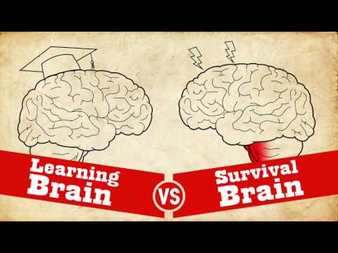
Impact of Trauma on the Brain
Notes:
To Know: This video is 5 minutes. Impact of trauma on the brain. Dr. Jacob Hamm illustrates in his youtube video ( https://youtu.be/KoqaUANGvpA) the differences between a calm state for learning and a brain attuned to survival. He talks about the learning brain as the balcony view and able to look over the forest as to what is going on. He describes the survival brain as someone who thinks only in black and white and are filled with doubt and panic. He states that survival brain always trumps learning brain. When we are in our emotional brain, learning will not occur. We can’t always predict individually or for those we are working with what triggers our brains to move from the thinking brain to the emotional brain—our survival brain.
To Say: The first step in understanding the complexity and the impact trauma can have on a child is to explore how trauma can impact the brain. This video illustrates that impact as it relates to learning.
Resource:
https://youtu.be/KoqaUANGvpA

Slide 16
Survival Brain
Increased
Decreased
Emotional instability
Anxiety
Irritability
Anger
Frustration
Impulsivity with regards to language or actions
Problem solving
Communication skills
Emotional regulation
Ability to retrieve previously learned information
Decision making
Notes:
To Know: The importance of understanding how students who have experienced trauma will tend to function in survival brain more than others.
To Say: This information is the foundation for understanding all other areas that are impacted by trauma. When a person is in survival brain they are focused on stress and perceived danger or a threat and not able to focus on learning. They have an increase in emotional instability which can present in a variety of ways including: anxiety, irritability, anger, and frustration as well as an increase in impulsivity with regards to language or actions. They may have a decreased ability to problem solve, communicate with others, regulate their emotions, retrieve previously learned information, and make decisions. All of these skills are essential to the learning process and therefore would make it extremely difficult for those who may be functioning in survival brain to engage in the classroom appropriately. It is important for educators to understand this so that they can create those safe and supportive environments that will allow all students to access their learning brain.

Slide 17
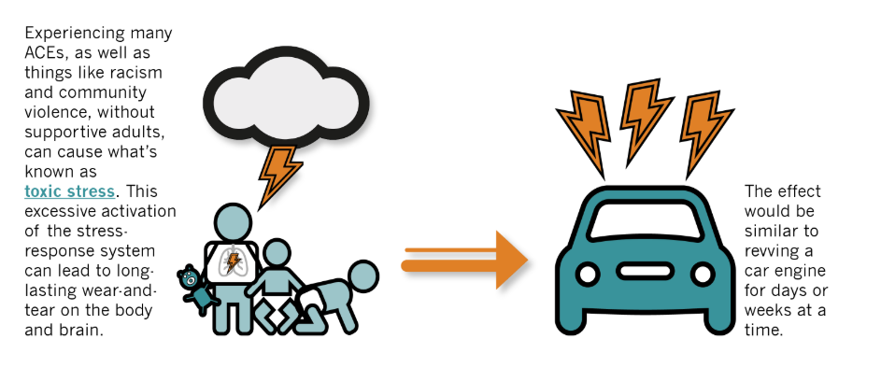
Chronic Stress
Notes:
To Know: Chronic stress can lead to wear and tear on the body and brain.
To Say: Now let’s talk about the cumulative impact of trauma. One key concept in our trauma-sensitive work is understanding of the stress-response system. Our bodies and brains react to danger in order to keep us safe. Trauma can make this system less effective, causing our stress-response system to activate whether or not real danger is present. This information can get very technical when we explore the neurological systems behind the stress response system.
Experiencing many ACEs along with things like racism or community violence can literally “get under our skin” and cause toxic ongoing stress. this excessive activation of the stress response system can lead to wear and tear on the body and brain. To give you a visual it would be the same as reviving a car engine for days or weeks at a time.
Reference:
Center on the Developing Child, Harvard University
https://developingchild.harvard.edu/about/

Slide 18
Small Group Discussion
If a student is functioning in their survival brain, how might their school day be impacted?
Notes:
To Say/To Do: Now let’s take some time to discuss this in our small groups. Consider the following question: If a student is functioning in their survival brain, how might their school day be impacted? Consider how this applies to the entire school day and not just their time spent in the classroom. (arrival, lunch, hallways, interactions with friends, assemblies, PE, recess etc.)

Slide 19
Impact of Trauma on Relationships
The child may have difficulty forming and maintaining relationships.
There may be little trust in those around them as they are seeking protection or safety.
The child may demonstrate emotions or responses based on the modeling they have seen in other situations .
The child begins to perceive the world as dangerous, leading to a sense of vulnerability and distrust of others.
Notes:
To Know: Trauma can impact relationships
To Say: Let’s take a look at how experiencing trauma can impact various aspects of relationships. To begin with, a child who experiences trauma may have difficulty forming and maintaining relationships. The template for relationships is developed between the bond between the child and their caregiver. The caregiver serves as the source of the child’s safety, provides for the child’s needs, and guides them in their understanding of themselves and others. Healthy attachments provide the building blocks for later relationships and a child’s ability to master developmental tasks by: regulating emotions and self-soothing, developing trust in others, helping children understand themselves and the world around them.
When a child experiences trauma, it can alter those experiences. They may have difficulty trusting those around them as they are seeking protection or safety. The child may demonstrate emotions or responses that are based on the modeling they have seen in other situations. Remember, they are often functioning in survival brain so they may perceive the world as dangerous. This can lead to a sense of vulnerability and distrust of others as they navigate the world around them.

Slide 20
Impact of Trauma on Learning
Deficits in executive functioning
Decreased language and communication skills
Inability to retrieve information
Decreased concentration and attention
Inability to see cause and effect
Lack of organizational ability
Notes:
To Know: Trauma can impact learning
To Say: In addition to relationships, experiencing trauma can certainly impact learning within the classroom. Many children who have experienced trauma may have deficits in executive functioning. They may have decreased language and communication skills, especially when they are functioning in survival brain. They may be unable to retrieve previously learned skills and information and may have a decreased ability to concentrate and pay attention to the task at hand. Children who have experienced trauma may also have difficulty understanding cause and effect relationships and may lack organizational skills that can impact them across their academic day. We will explore more of the impact of relationships and learning in module 3.

Slide 21
Small Group Discussion
Given the impact trauma can have on learning, what might teachers need to consider when planning for the school day?
Notes:
To Say/To Do: Now let’s take some time to discuss this in our small groups. Consider the following question: Given the impact trauma can have on learning, what might teachers need to consider when planning for the school day? Consider: What routines and procedures will be important? How will this impact your instructional planning?

Slide 22
Impact of Trauma on Behavior
Behavior is the language of students who have experienced trauma
Most children lack the language skills to describe how they are feeling, so behavior is their expression
Most expressive behaviors used by children are considered “negative”
Notes:
To Know: Trauma can impact behavior
To Say: The most important thing to remember when considering the impact trauma can have on behavior is that behavior is feedback for us. Behavior is the language of students who have experienced trauma. Most children lack the language skills to describe how they are feeling, so behavior is their expression. Unfortunately, most expressive behaviors are considered negative as they many interfere in the learning process but it is important for us, as educators, to remember to shift our perception. If we view behaviors as a language and therefore feedback for us, then we can approach that behavior with an instructional mindset.

Slide 23
Behavior as a Survival Technique
Many of the most challenging behaviors are strategies that have helped the child to survive abusive or neglectful situations and have been generalized to other environments (e.g., school)
Notes:
To Know: Behavior as a survival technique
To Say: If we recognize that behavior is feedback as a language of students who have experienced trauma it is also important to remember this: Sometimes, many of the most challenging behaviors are strategies that have helped a child to survive abusive or neglectful situations and have been generalized to other environments like school. Behavior continues because it is reinforced and meets a need. Our challenge is to recognize why the behavior is occurring so we can intervene and teach appropriate replacement skills. Again, we will go more into this in module 3.

Slide 24
Impact of Trauma on Worldview
Typical Development
Developmental Trauma
Belief in a predictable and benevolent world
Positive self-worth
Hopeful and optimistic about future
Empowered
Basic mistrust of others
Belief that the world is unsafe
Negative self-worth
Fear and pessimism about the future
Hopeless and powerless
Notes:
To Know: Trauma can impact worldview in many ways
To Say: When we are working with children who have experienced trauma it is also important to remember that their experiences can impact the way they view the world around them. Children who have experienced typical development often believe they live in a predictable and benevolent world. They usually view themselves positively and are hopeful and optimistic about the future. They usually feel empowered and have a sense of stability about what is happening around them.
In contrast, children who have experienced trauma often develop a basic mistrust of others and can view the world is unsafe. Remember that they are often functioning in their survival brain so they may be constantly on the alert for danger or threat. They may have a negative self-worth and feel fear and pessimism about the future. Additionally, there may be feelings of hopelessness and they may feel powerless within their environment.

Slide 25
Trauma Changes Perceptions
I am not safe
I cannot trust others
I cannot trust myself
I cannot depend upon others
I am not worthy of care
I deserve the bad things that happen to me
It’s my fault
Notes:
To Know: Trauma can change perceptions.
To Say: Children who have experienced trauma may view the world through this lens. They may feel that they are not safe in any environment, including school. They may feel that they cannot trust others, especially adults. They may not feel that they can trust themselves based on patterns from their past. Finally, they may feel that they are not worthy of care, that they deserve to have bad things happen to them and that it is their fault.

Slide 26
What is your reality?
Directions:
Step 1: The rectangular blocks are single events. Without giving it too much thought, use one color pencil or marker to draw mental lines from each box to one of the three bubbles based on your response to that event would personally be.
Step 2: Using another color, and the same directions, draw what the lines might be for your own child or a child you work with.
Got ill the day of a big work or homework deadline and couldn’t finish on time.
Cut your toe open
Sibling, partner yells at you for leaving dishes in the sink
Death of a parent or primary caregiver
Worrisome feeling is noted. Brief, temporary feelings of discomfort; but able to redirect thoughts, mood, and actions.
Concerns persist for more than a day, but less than 3-4; some psychological impact (more easily startled, some sleep disruption); minimal but notable impact on interpersonal relationships.
Really upsetting, persistent fear or anxiety; impacts sleeping; eating, thought patterns; significant impact on interpersonal relationships.
Got in fender bender accident
Were given a book that was to read or understand
Plans for outing were changed at last minute
Wildfire threatens your home
Your place of worship was vandalized
Notes:
To Say/To Do: We are going to take a few minutes to reflect on perceptions and worldview. Take some time to complete this activity independently. (After the group completes this activity consider the following questions) What did you notice?How do you feel your reality might match up with a child’s or student’s reality? How will this impact your behavior and practices moving forward?
Resource:
Handout:

Slide 27
Why Should Schools Address Trauma?
Reduce negative impact of trauma
Establish a sense of safety for students and families affected by trauma
Create positive environments to support student learning
Teach critical social emotional skills
Create links to outside resources
Notes:
To Know: It is important for schools to address trauma.
To Say: This module has allowed us to begin to explore the impact of trauma. We have discussed the different categories as well as the impact it can have on the brain, relationships, learning, behavior and worldview. The impact is significant both in and out of the classroom. Every classroom, in every community, in every state in our country is impacted and, we, as educators, have to make adjustments in order to address the needs of all of our students. When we, as a school, address trauma, we can reduce the impact, establish a sense of safety, create positive environments, teach critical social emotional skills and create a link to outside resources. While this is especially important for students who have experienced trauma, it is important to remember that these practices can benefit all students in our buildings.

Slide 28
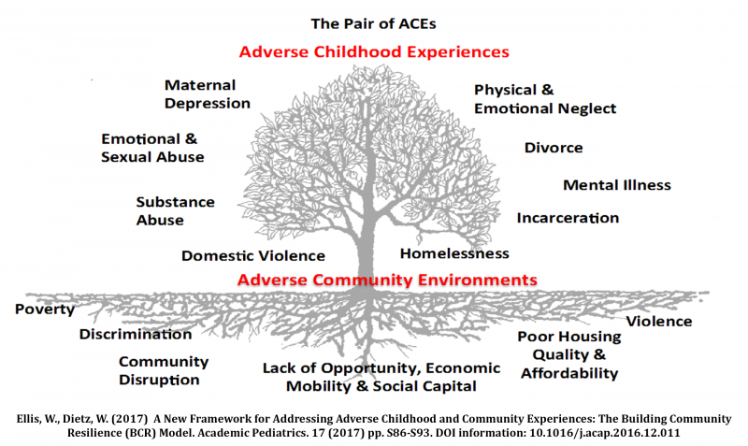
Schools Can be a Foundation of Support
Notes:
To Know: Schools can be a foundation of support
To Say: Adverse childhood experiences impact so many of our children in every community across the country. The negative effects of exposure to adversity can be seen in families from generation to generation. While this does occur across all races, genders and income levels, children and adults living in adverse community environments bear a greater burden of negative health outcomes. As this tree illustrates, this disparity in health outcomes may be connected to the lack of access to support systems and resources that can help individuals overcome adversity. This lack of support creates a foundation that feeds the negative patterns that are already established. The tree is planted in poor soil that is steeped in systemic inequities, robbing it of nutrients necessary to support a thriving community.
It is important for us to understand that we, as educators, have the power to create a safe, positive, consistent, and nurturing environment in the school that can serve as a foundation. This foundation of support can spread to other “root systems” to establish a more consistent and solid foundation for individuals experiencing adversity. Every system or organization that touches an aspect of a child’s life and family can contribute to community resilience. Rich soil results in a resilient community. We can build a foundation of support for individuals and it can start in our schools.
Reference: (Nurius, 2016)

Slide 29
Team Talk: What are your next steps
How will you continue these conversations?
How will you keep these things in mind when planning?
Fill this in on your Action Plan under “Objectives and Action Planning”
Notes:
To Know: Action planning supports engagement in the work and next steps
To Say: We’ve now completed the introduction to trauma. This your time to pause and reflect on the “how”. How will you continue these conversations? How will you keep these things in your mind when planning? Please fill this in on your action plan under objectives and action planning.
Handout: Action Planner

Slide 30
References
Center on the Developing Child, Harvard University
https://developingchild.harvard.edu/about/
Trauma and Violence: Substance Abuse & Mental Health Services Administration
Rachel E. Goldsmith PhD, Christina Gamache Martin MS & Carly Parnitzke Smith MA MS (2014) Systemic Trauma, Journal of Trauma & Dissociation, 15:2, 117-132, DOI: 10.1080/15299732.2014.871666
Massachusetts, Washington State lead U.S. trauma-sensitive school movements

