Slide 1
Hidden Slide #1
This Module was designed to be used in the following manner.
The audience for this Module is division and school teams.
This Module is meant for whole staff, team, and division presentations.
Following this training, participants should complete the Action Plan document to determine next steps.
There are eight sections in this module. Teams are not required to complete all components of the Modules. Instead, participants will complete only those Modules that fit the needs of their school.
Notes:
Module 1 is divided into several sections. Each section can be completed in 30 minutes or less.

Slide 2
Hidden Slide #2
In person training
Presenter notes and information
Notes:
In-person training suggestions
This module can be broken down into sections. Each section of Module 4 should be about 30 minutes to complete. This modules provides strategies that can be used for staff and students in trauma sensitive schools. You may want to add or enhance portions with visuals and examples that will resonate with your audience. As a reminder, always be sure to include appropriate citations when adding resources. Also, you might look to the resources and activities sections for additions that may be helpful.
In summary
This module outlines strategies that can be used in trauma sensitive schools
It can be adapted to individual contexts
The training should last about 4 hours for the entire module or 30 minutes for each section.
Presenter notes information
Presenter notes are included in the PowerPoint. Background information for the presenter is shown as “To Know.” Statements to be shared with participants are shown as “To Say.” In some instances, the “To Know/To Say” are combined.The presenter notes also include “To Do” prompts and cues for “Handouts”.
Additional activities, examples, videos, etc. are being developed. A presenter may add material from the resources and activities section on the website.
Breaks should be inserted at the discretion of the presenter based on the needs of participants.
Additional activities, examples, videos, etc. are being developed. A presenter may add material from the resources and activities section on the website.
Breaks should be inserted at the discretion of the presenter based on the needs of participants.

Slide 3
Hidden Slide #3
Supplies needed
WIFI access for presenter and participants
Access to videos (through WIFI if available, but download to flash drive as a back-up)
Chart paper
Markers
Post-it-Notes
Notes:
To Know
These supplies are needed for the Trauma Professional Learning Modules.

Slide 4
Hidden Slide #4
Handouts for this Module
Action Planner
Notes:
To Know
The Participant and Presenter Materials are located on the vtss-ric website.
References

Slide 5
Hidden Slide #5
Key Terms in This Module:
5 to 1
Choral Response
Blended Learning
Opportunities to Respond
Notes:
To Know
These are the key terms used throughout the module.

Slide 6
Academic Strategies
Notes:
To Know:
VTSS Professional Learning Modules are organized in the same manner. All schools can begin their journey with Module 1 which introduces the foundational knowledge around trauma and trauma sensitive schools. This powerpoint is part of Module 4 that shares strategies on how we create trauma-sensitive, safe and supportive schools.
To Say:
Welcome to the learning module, “Academic Strategies”. Let’s get started!

Slide 7
What We Will Know and Do
Build an understanding on how trauma impacts academics
Leave with some strategies that you could try in your classroom that support students of trauma
Notes:
To Know:
Go over the learning intentions targeted for this session
To Say:
During this module we hope you will begin to understand the importance of how trauma impacts school performance. There are many strategies to support students academically but we hope to provide you with a few strategies you can use.

Slide 8
Trauma and Academics
Focusing on academics while struggling with trauma is like “trying to play chess in a hurricane.”
Kenneth Fox - High School Teacher, Mount Vernon High School
Notes:
To Know: Small changes in the classroom can have a great impact on students impacted by trauma. It is critical that teachers realize that students impacted by trauma are not focused on academics, they are focused on surviving.
To Say: For some students, being traumatized is a constant state of mind. They can’t just turn this off when they enter the classroom.

Slide 9
Trauma and School Performance
Students dealing with trauma:
Are 2.5x more likely to fail a grade
Score lower on standardized assessments
Have more receptive and expressive language difficulties resulting in poor relationships with adults and peers
Are identified for special education services more frequently
Are suspended or expelled more often
Notes:
To Know: This is the Why.
To Say:Organization, comprehension, memory, the ability to produce work, trust and engagement on learning are key foundations that students need to be able to read, write, solve problems, take part in the classroom. Students also need to be able to self-regulate attention, emotions, and behavior. Students impacted by trauma have a hard time with these foundations for learning due to their experiences and it ultimately can affect their school performance in a variety of ways.

Slide 10
What Does it Look Like?
Classroom instruction is differentiated to allow students impacted by trauma to achieve academically consistent with their age and grade.
Additional support is provided for students who are not successful.
Notes:
To Know: We want to move from “What is wrong with the student” to “What does this student need to reach their full potential”.
To Say: We know that teachers are not mental health professionals. Trauma sensitive awareness helps teachers approach classroom instruction in ways that allow students impacted by trauma to achieve, feel supported, and connected. We use many of the same strategies we should be using for all kids - how do I scaffold to get them there, etc.

Slide 11
In Action
Notes:
To Say: This is a good video to show the impact trauma has on learning and what that looks like.
To Do: Play video https://youtu.be/UPwdWLWYqBI. Video is 9 minutes.
Reference: https://youtu.be/UPwdWLWYqBI
Helping Traumatized Children Learn: https://youtu.be/UPwdWLWYqBI

Slide 12
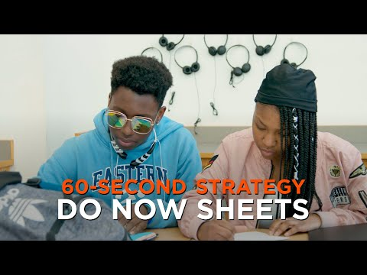
An Example in Blended Learning
Notes:
To Know: This is a good video example of using strategies in a blended learning environment.
To Say: With everything going on and more schools moving towards online learning or blended learning this is a good example of strategies teachers can use to check in and connect with their students.
To Do: Play Video: https://youtu.be/COG_P1VnYcU. This video is 1 minute.
Reference:
https://youtu.be/COG_P1VnYcU

Slide 13
Strategies to Promote Academic Skills
Notes:
To Know: Transition Slide

Slide 14
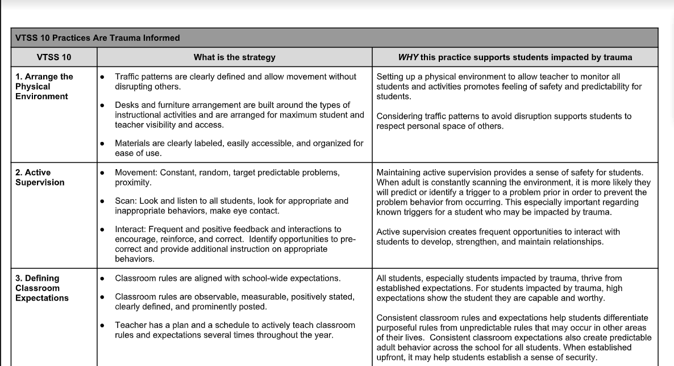
Strategies - VTSS 10
Notes:
To Know/To Say: At VTSS we have outlined our top 10 classroom practices that are also trauma informed. It is important to note that trauma sensitive practices support all students. The VTSS 10 include; physical environment, active supervision, classroom expectations, routines and procedures, opportunities to respond, formative assessment, scaffolding, acknowledgment and behavior specific praise, error correction and feedback. We hit on most of these strategies in Module 4.
Handout:
https://drive.google.com/file/d/1fv6ZoZcqvknpDBpimYYP8bt5VrQ6xCNx/view?ts=5e865625

Slide 15
Opportunities to Respond Strategies
Group
Individual
Choral response
Partner discussion
Small-group discussion
Hand signals/gestures
Response Cards
Marking something
Pointing at something
Whiteboards
Clickers
Calling individually/ randomly
Written response
Exit/Entrance slips
Structured note-taking
Copying from board
Journaling
Anticipation Guide
Notes:
To Know: There are many strategies on Opportunities to Respond. This powerpoint will focus on one.
To Say:You have looked at some powerful evidence based practices, so let’s focus on a few - remember the importance of language and communication - how we can promote that, and also promote student voice. This list shows the many ways you can elicit responses from students. Group responses are quick and easily monitored by the teacher. During planning sessions with colleagues, discuss types of responses that will be effective during different parts of a lesson.

Slide 16
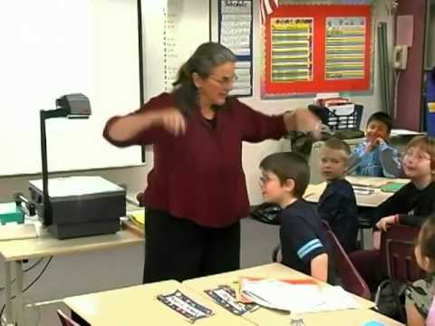
Example of Choral Response
Notes:
To Know/To Day: Choral response is an effective strategy to increase the frequency of student responses, refocus student attention, and provide rehearsal of important information.
To Do: Play video https://youtu.be/Em-VRAqZTck. 1 minute
Reference:

Slide 17
Feedback: Acknowledgement
Students should experience predominantly positive interactions
(5 positives: 1 negative)
in the classroom.
For students in vulnerable situations, the frequency is higher: 10:1 or 13:1
Notes:
To Know: 5 to 1 is a good strategy for feedback and acknowledgment.
To Say: In a recent book How Full is Your Bucket, psychologists Donald O. Clifton and Tom Rath propose a metaphor of 'looking at positive and negative interactions during the day. Imagine we all have a bucket within us that needs to be filled with positive experiences, such as recognition or praise. When we're negative toward others, we use a dipper to remove from their buckets and diminish their positive outlook. When we treat others in a positive manner, we fill not only their buckets but ours as well. Students should experience 5 positives to 1 negative in the classroom. Now, let’s think about students who are in vulnerable situations. You may find that 5 to 1 is not working in building a connection with the student. Maybe you have to increase the positive to 10, 11, 12, or 13? As you continue to build a relationship with your student you will discover if this true. We also know that some people are naturally empowered by affirmation--it’s their love language. Imagine if you are a child in which this is more naturally true for you, and also existing in your life is no outlet for affirmation, and worse still--toxic stress, chaos, or trauma?

Slide 18
How does 5 to 1 happen?
Making eye contact
Asking if assistance is required
Smiling or nodding
Welcoming
Offering a greeting
Providing positive feedback regarding appropriate behavior
Maintaining an attitude of respect and support, even when correcting behavior
Notes:
To Say: How does 5 to 1 happen? Simple things that are quick, easy, and cost nothing-- making eye contact, reaching out when you see the student struggling, smiling, or a look of approval, standing at the door and welcoming each student as they enter the classroom and call them by name. Make sure you are striving to provide positive feedback regarding their appropriate behavior, and being respectful and calm when correcting behavior.

Slide 19
Practice
Instructions: Identify one of the strategies we have discussed (or one from the VTSS 10) that you would like to try.
How will you put this into place?
What will you immediate next steps be?
How will you assess this strategy?

Slide 20
Team Talk: Review the “How”
How will you adjust your practices to support learning for students who have experienced trauma?
How will you involve families and students in practices?
Fill this in on your Action Plan under “Objectives and Action Planning”
Notes:
To Know: Action planning supports engagement in the work and next steps
To Say:
We’ve now completed the module “Academic Strategies”. This your time to pause and reflect on the “how”. How will you adjust your practices to support learning for students who have experienced trauma?Please fill this in on your action plan under objectives and action planning.
Handout: Action Planner

Slide 21
Resources/References
Helping Traumatized Children Learn: https://youtu.be/UPwdWLWYqBI
https://youtu.be/COG_P1VnYcU.
https://youtu.be/Em-VRAqZTck
Rath, Tom, and Donald O. Clifton. 2004. How full is your bucket?: positive strategies for work and life. Harvard (18th ed.)

