Slide 1
Hidden Slide #1
This Module was designed to be used in the following manner.
The audience for this Module is division and school teams.
This Module is meant for whole staff, team, and division presentations.
Following this training, participants should complete the Action Plan document to determine next steps.
There are eight sections in this module. Teams are not required to complete all components of the Modules. Instead, participants will complete only those Modules that fit the needs of their school.
Notes:
Module 1 is divided into several sections. Each section can be completed in 30 minutes or less.

Slide 2
Hidden Slide #2
In person training
Presenter notes and information
Notes:
In-person training suggestions
This module can be broken down into sections. Each section of Module 4 should be about 30 minutes to complete.
This modules provides strategies that can be used for staff and students in trauma sensitive schools. You may want to add or enhance portions with visuals and examples that will resonate with your audience. As a reminder, always be sure to include appropriate citations when adding resources. Also, you might look to the resources and activities sections for additions that may be helpful.
In summary
This module outlines strategies that can be used in trauma sensitive schools
It can be adapted to individual contexts
The training should last about 4 hours for the entire module or 30 minutes for each section.
Presenter notes information
Presenter notes are included in the PowerPoint. Background information for the presenter is shown as “To Know.” Statements to be shared with participants are shown as “To Say.” In some instances, the “To Know/To Say” are combined.The presenter notes also include “To Do” prompts and cues for “Handouts”.
Additional activities, examples, videos, etc. are being developed. A presenter may add material from the resources and activities section on the website.
Breaks should be inserted at the discretion of the presenter based on the needs of participants.

Slide 3
Hidden Slide #3
Supplies needed
WIFI access for presenter and participants
Access to videos (through WIFI if available, but download to flash drive as a back-up)
Chart paper
Markers
Post-it-Notes
Notes:
To Know
These supplies are needed for the Trauma Professional Learning Modules.

Slide 4
Hidden Slide #4
Handouts for this Module
Action Planner
Notes:
To Know
The Participant and Presenter Materials are located on the vtss-ric website.

Slide 5
Regulation Skills
Notes:
To Know:
VTSS Professional Learning Modules are organized in the same manner. All schools can begin their journey with Module 1 which introduces the foundational knowledge around trauma and trauma sensitive schools. This powerpoint is part of Module 4 that shares strategies on regulation skills.
To Say:
Welcome to the learning module, “Regulation Skills”. Let’s get started!

Slide 6
What We Will Know and Do
understand the importance of regulation skills
explore several strategies that can be used for regulation
Notes:
To Know:
Go over the learning intentions targeted for this session
To Say:
During this module we hope you will gain an understanding of the importance of regulation, as well as provide strategies develop regulation skills.

Slide 7
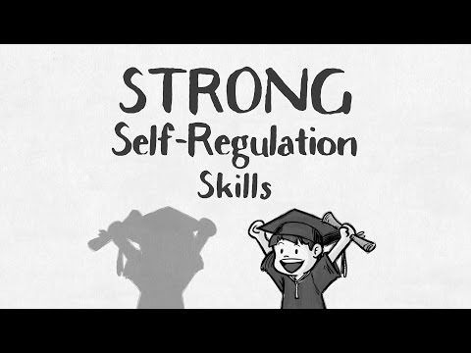
Why this is important
Notes:
To Know: video is 2:22; https://youtu.be/m4UGDaCgo_s
To Say: Let’s watch a short video about the why self-regulation skills are foundational. (Following the video, provide opportunity for discussion; takeaways.)

Slide 8
Explicitly teach self-regulation
set aside a planned time to teach: morning meeting, advisory, first 5 minutes of class, lunch group, etc.
identify skills to teach
use a curriculum
develop your own areas of focus
provide a variety of activities
provide opportunities for practice
discuss and self-reflect
Notes:
To Know: Managing emotions is a skill that needs to be taught
To Say: Just as it was stated in the video, managing emotions is not inborn, but it is teachable. Learning to monitor and manage emotions is a skill that we depend on every day. So how do we explicitly teach self-regulation?
set aside a planned time to teach: morning meeting, advisory, first 5 minutes of class, lunch group, etc.
identify skills to teach
use a curriculum
develop your own areas of focus
provide a variety of activities; use literature or real life scenarios to generate discussion
provide opportunities for practice, through role plays, games, or even as situations naturally occur within the classroom
discuss and self-reflect

Slide 9
Provide prompts to students
close your eyes and relax your muscles
take 10 deep breathes
think about something that makes you happy
picture a stop sign
hit the pause button
Notes:
To Know/Say: Once regulation skills are taught, teachers can prompt students, verbally or visually, to pause and practice or use those skills

Slide 10
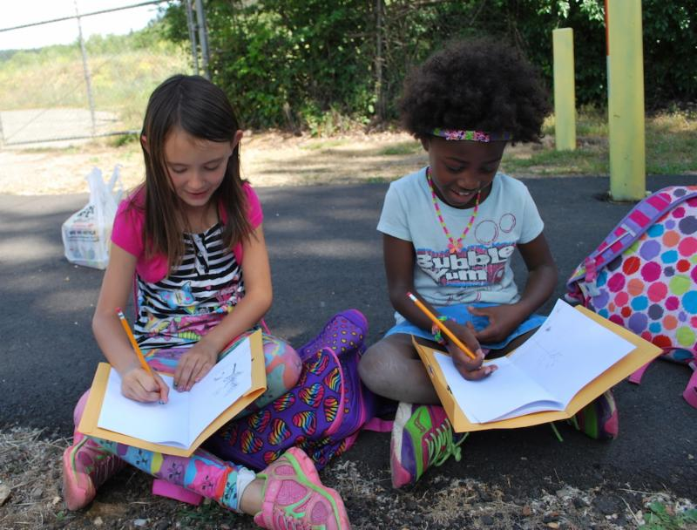
Activities for regulation
Write in a journal
Read a book
Listen to music
Exercise
Change activities
Notes:
To Know/say: Each individual has their own technique that helps them to regulate. Have students explore different options to see what helps them the most. Some possible activities are writing in a journal, reading, listening to music, exercise, or just changing activities or environments. Take a minute and think about what activities work for you.

Slide 11
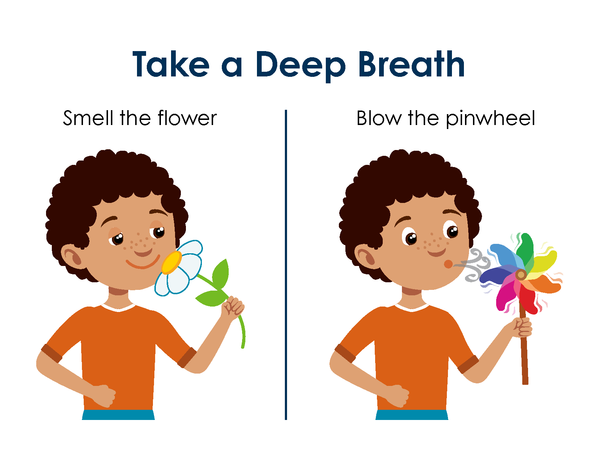
Use of Visuals
Notes:
To Know/say: When upset, it is more difficult to access the reasoning part of our brains. Therefore, visual cues often assist individuals with using their regulation skills. Visuals can be posted in the classroom or on the desks. For some students, they may do better with a social story or script to guide them through using their skills.

Slide 12
Movement
Notes:
To Know: https://youtu.be/uMuJxd2Gpxo
To Say: Movement is a great way to help with regulation. Teachers can incorporate movement breaks into lessons, provide brain breaks between instruction, and provide opportunities for physical exercise and recess. Let’s take a moment to practice. Everyone one stand up and let’s move!!! (Play the video)

Slide 13
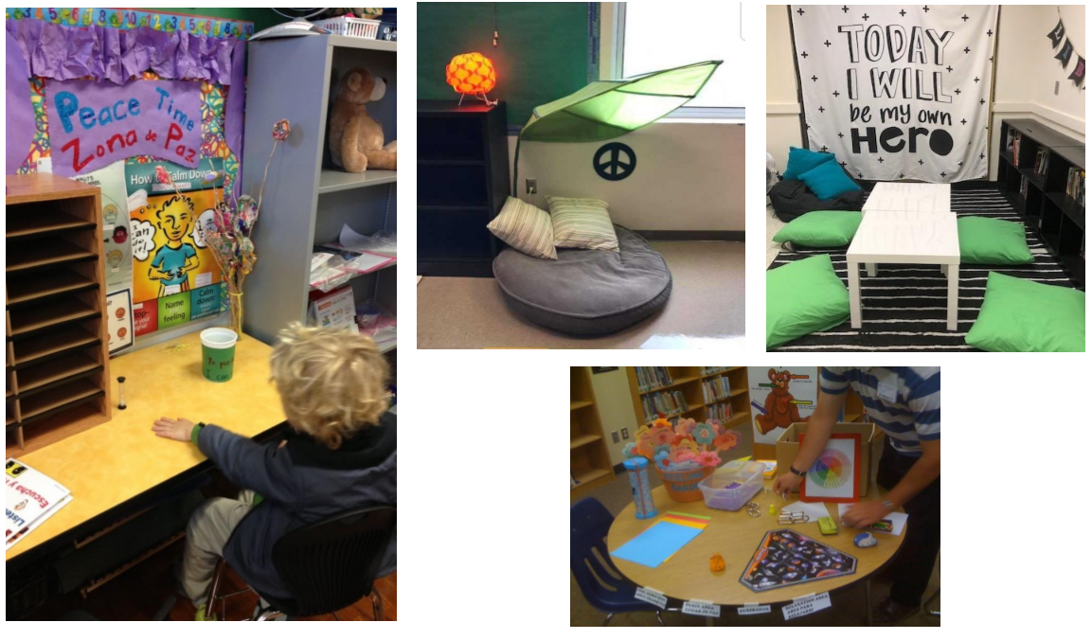
Calm Space
Notes:
To Know/Say: Sometimes students and adults just need a break to have time to “reset” A proactive strategy is to have a designated space where individuals can go and have an opportunity to self-regulate. A space within the classroom (or school) can be designated as an area for students (and staff) to use when they need to take a break. For students, explain the purpose of the space and set up procedures and routines for how the space will be accessed, length of time it can be used, as well how to use materials within the space. Provide items such as fidgets, sensory bottles, coloring sheets, etc. that the student can use to regulate. It is important that this space is set up as a support, and not as a time out area. Also, communicate that it is healthy and normal to sometimes need to take a break!

Slide 14
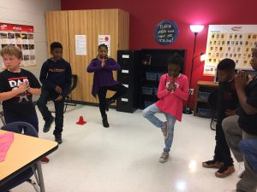
Mindfulness/Guided Meditation
mindful minutes
breathing exercises
yoga stretches
activities led by teacher or video
Notes:
To Know: Individuals need a variety of options for regulation. There is a lot of research around the benefits of mindfulness and meditation; however, it is important to note that for some individuals, especially those who have experienced trauma, these procedures may be uncomfortable. Students should always be given the option not to participate in activities.
To Say: Incorporating mindfulness or yoga practices into your classroom is another option to provide students with opportunities for regulation. There are many resources available, including videos that will help lead the class. Many teachers and students have reported benefits of these techniques; however, it is also important to be sensitive that not all techniques work for everyone, and they should be optional.
Resource: Nine Ways to Ensure Your Mindfulness Teaching Practice is Trauma-Informed

Slide 15
Reflection
Which strategies can you teach and use into your classroom to help students to self-regulate?
How will you make sure you follow through with incorporating regulation skills into your daily routines?
Notes:
To Know/To Say/To Do: Work with participants on reflection either individually or in a group.

Slide 16
Practice
Instructions: Identify one of the strategies we have discussed (or one of your own ideas) that you would like to try. Pick something that will take relatively little effort to implement.
–Think about particular students you would like to use the strategy with
Why did you pick the strategy you did?
How would you put it in place or get started?
How would you practice it? Or how would your students practice it?
What will your immediate next steps be?
Notes:
To Say/To Do:

Slide 17
Team Talk: Review the “How”
How will you adjust your practices to support learning for students who have experienced trauma?
How will you involve families and students in practices?
Fill this in on your Action Plan under “Objectives and Action Planning”
Notes:
To Know: Action planning supports engagement in the work and next steps
To Say:
We’ve now completed the module “Regulation”. This your time to pause and reflect on the “how”. How will you adjust your practices to support learning for students who have experienced trauma?Please fill this in on your action plan under objectives and action planning.
Handout: Action Planner

Slide 18
Resources
Nine Ways to Ensure Your Mindfulness Teaching Practice is Trauma-Informed
https://youtu.be/m4UGDaCgo_s
https://youtu.be/uMuJxd2Gpxo

